Slide 1
Machine Learning-Driven Identification and Categorization of Ion-Kinetic Instabilities in Hybrid-PIC Simulations
Viacheslav Sadykov¹, Leon Ofman^{2,3}, Scott Boardsen^{3,4}, Yogesh^{2,3}
¹Georgia State University
²Catholic University of America
³NASA Goddard Space Flight Center
⁴University of Maryland, Baltimore County

Slide 2
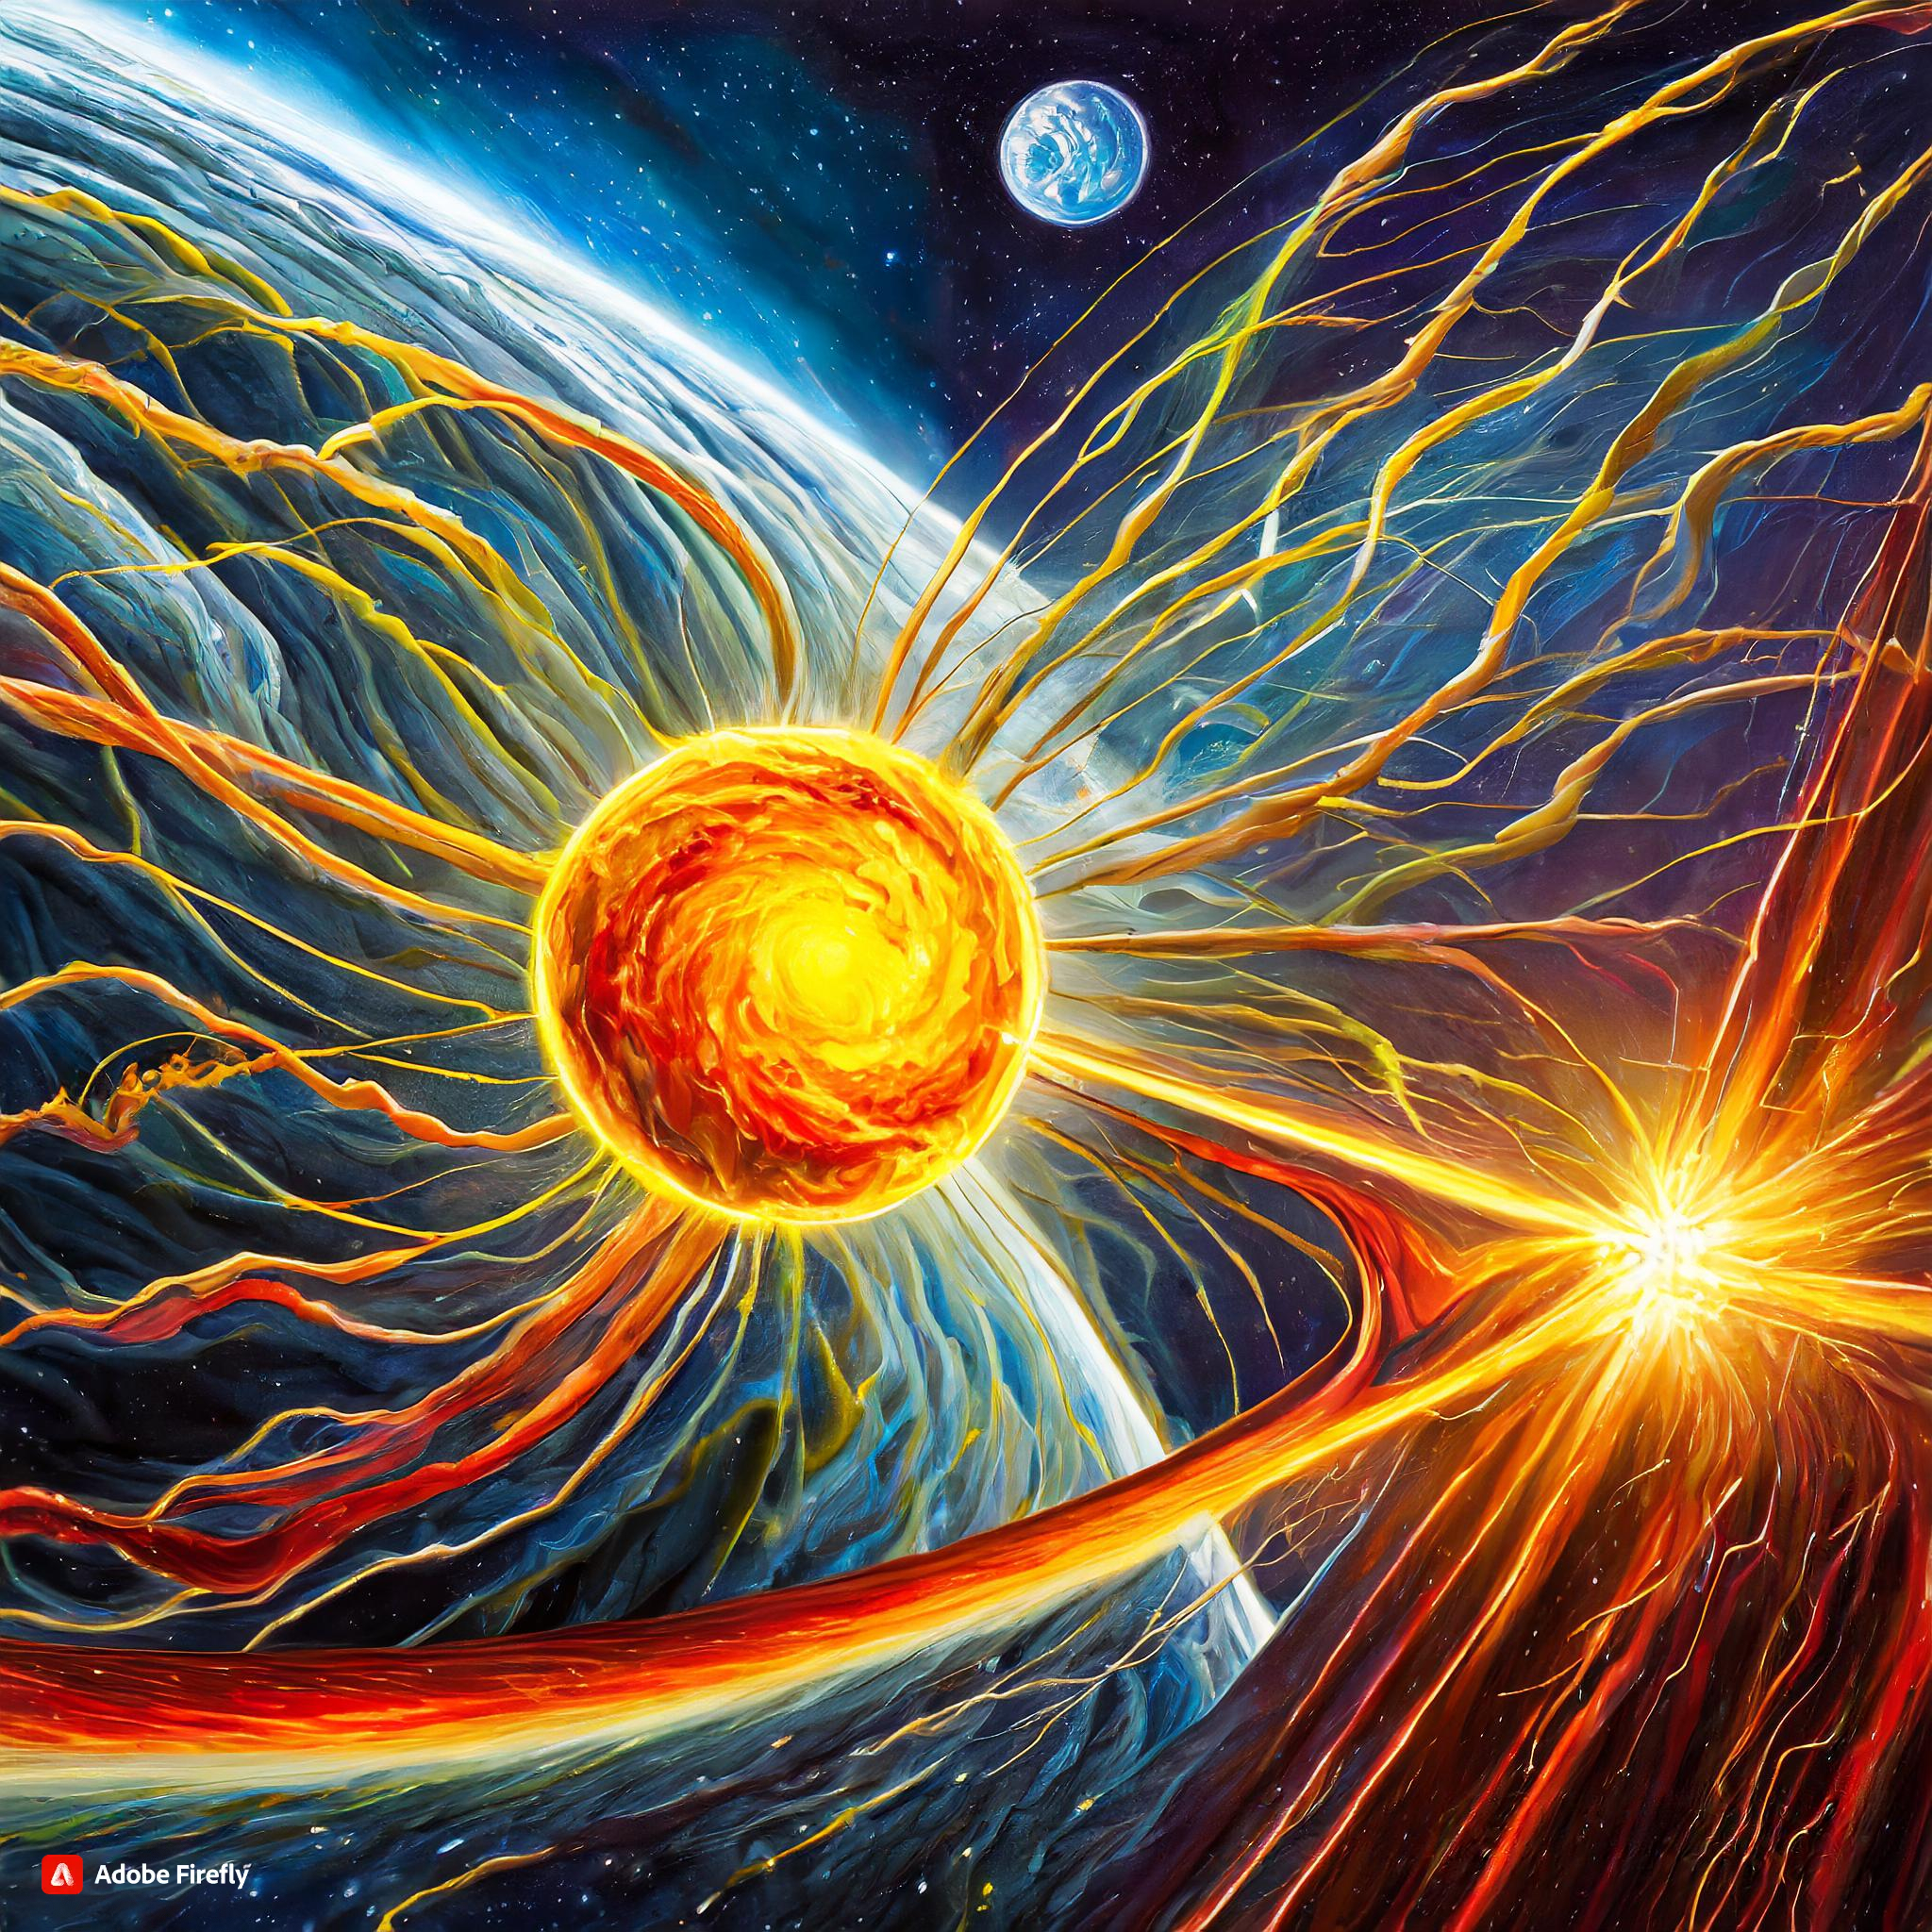
Ion-Kinetic Instabilities in Solar Wind
The physical processes leading to the acceleration and heating of the solar wind (SW) are not fully understood
Ion-driven kinetic instabilities can play an important role in the heating and acceleration of the SW plasma in the inner heliosphere
Our goal is to explore the potential of the automated characterization of instabilities in the SW plasmas using Hybrid-PIC simulations and AI/ML
“Ion-kinetic instabilities in solar wind” according to a generative AI. Credits: Adobe Firefly

Slide 3
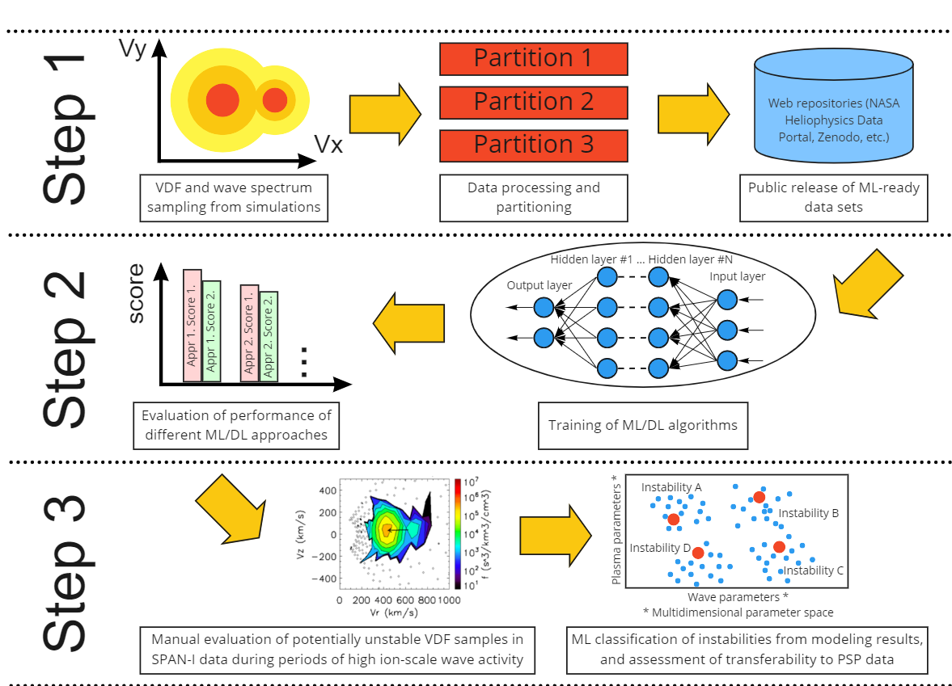
Machine Learning Roadmap

Slide 4
Hybrid-PIC Simulations
The ions are treated fully kinetically as particles using the Particle-In-Cell (PIC) method, while electrons are modeled as fluid (Ofman et al. 2010)
The proton VDFs in the V_{x}-V_{z} plane for the initial state and two later times during the evolution (upper panels) at t=0, 1200, and 3000 Ω_{p}⁻¹ obtained from the 2.5D hybrid model for the proton beam parameters guided by PSP data. The lower panels show the corresponding cuts along V_{x} through the peaks of the VDFs (Ofman et al. 2022).

Slide 5
Hybrid-PIC Simulations
# | Species | p-α drift, V_{A} | Anisotropies | Relative Populations | β for every species
1 | (2) p core, α core | 0.0 | 1.0, 0.5 | 0.9, 0.05 | 0.5, 0.5
2 | (2) p core, α core | 0.0 | 1.0, 0.75 | 0.9, 0.05 | 1.0,1.0
3 | (2) p core, α core | 0.42 | 3.36, 2.05 | 0.986, 0.007 | 0.08, 0.024
4 | (2) p core, α core | 0.0 | 4.3, 1.6 | 0.986, 0.007 | 0.08, 0.024
5 | (2) p core, α core | 0.32 | 4.3, 1.6 | 0.986, 0.007 | 0.08, 0.024
6 | (2) p core, α core | 0.32 | 1.86, 1.0 | 0.986, 0.007 | 0.10, 0.028
7 | (2) p core, α core | 0.0 | 1.0, 10.0 | 0.9, 0.05 | 0.0413, 0.0413
8 | (2) p core, α core | 2.0 | 1.0, 1.0 | 0.9, 0.05 | 0.0413, 0.0413
9 | (2) p core, α core | 1.5 | 1.0, 1.0 | 0.9, 0.05 | 0.0413, 0.04
10 | (2) p core, p beam | 1.5 | 1.0, 1.0 | 0.9, 0.10 | 0.0413, 0.010325
11 | (3) p core, p beam, α core | 0.0 | 1.0, 1.0, 1.0 | 0.819, 0.091, 0.045 | 0.429, 0.0916, 0.429
12 | (4) p core, p beam, α core, α beam | 0.0 | 1.0, 1.0, 1.0, 1.0 | 0.819, 0.091, 0.04, 0.005 | 0.429, 0.0916, 0.429, 0.0916
13 | (4) p core, p beam, α core, α beam | 0.0 | 1.0, 1,0, 1.0, 1.0 | 0.819, 0.091, 0.03, 0.015 | 0.429, 0.0916, 0.429, 0.0916
14 | (2) p core, α core | 1.2 | 1.0, 0.75 | 0.9, 0.05 | 0.10, 0.028
15 | (2) p core, α core | 1.2 | 3.35, 2.05 | 0.986, 0.007 | 0.10, 0.028
16 | (2) p core, α core | 1.5 | 1.5, 1.0 | 0.986, 0.007 | 0.10, 0.028

Slide 6
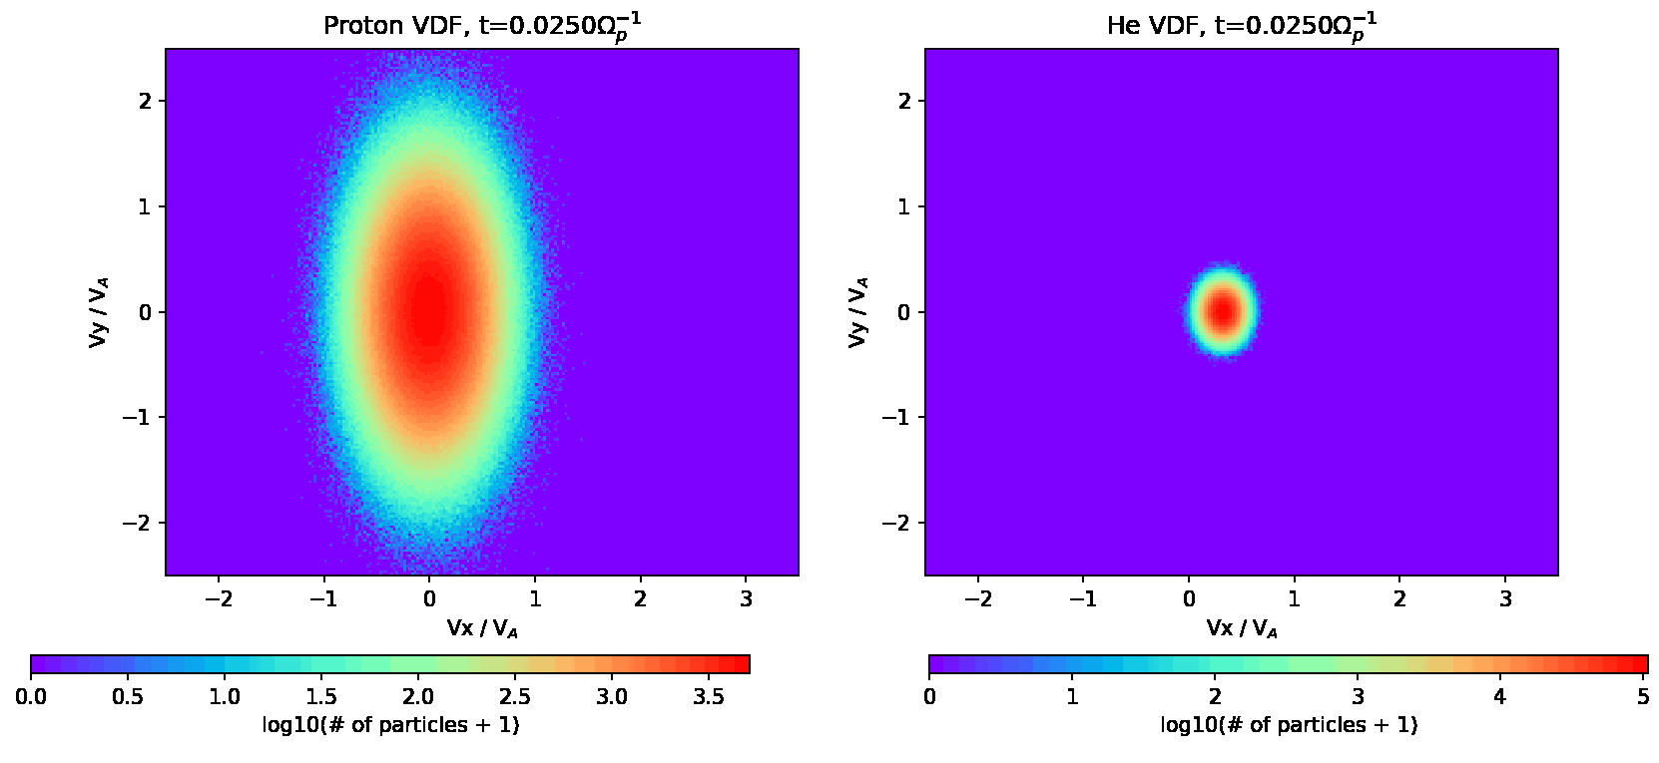
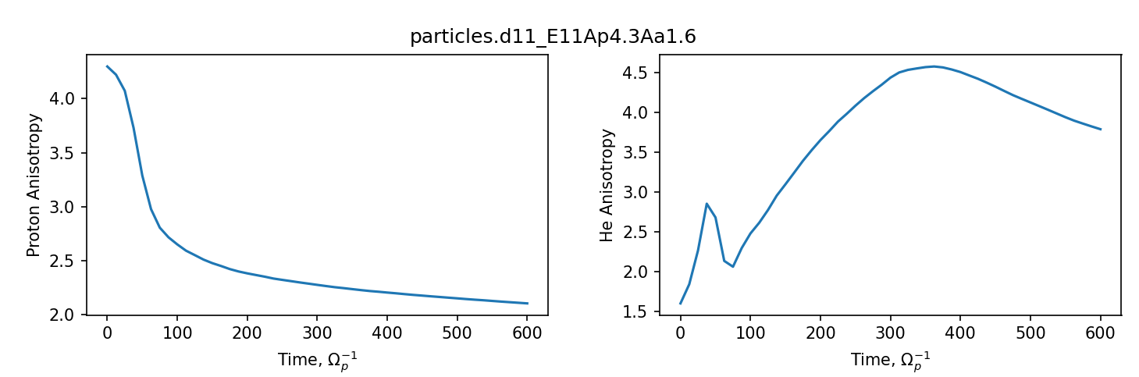
Python Package for Simulation Processing
We have developed a package to read and visualize the results of hybrid-PIC simulations
The package is publicly available at https://github.com/vsadykov/kineticsim_reader.git
Right: proton and alpha particle VDFs and anisotropies from simulations by Ofman et al. (2023)

Slide 7
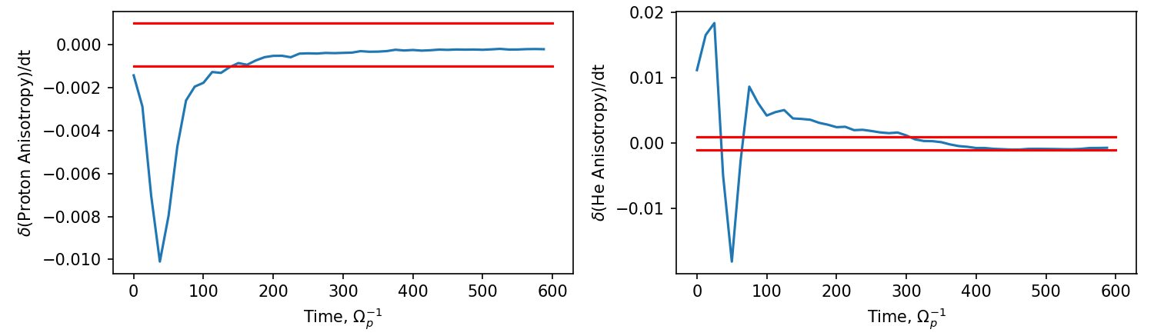
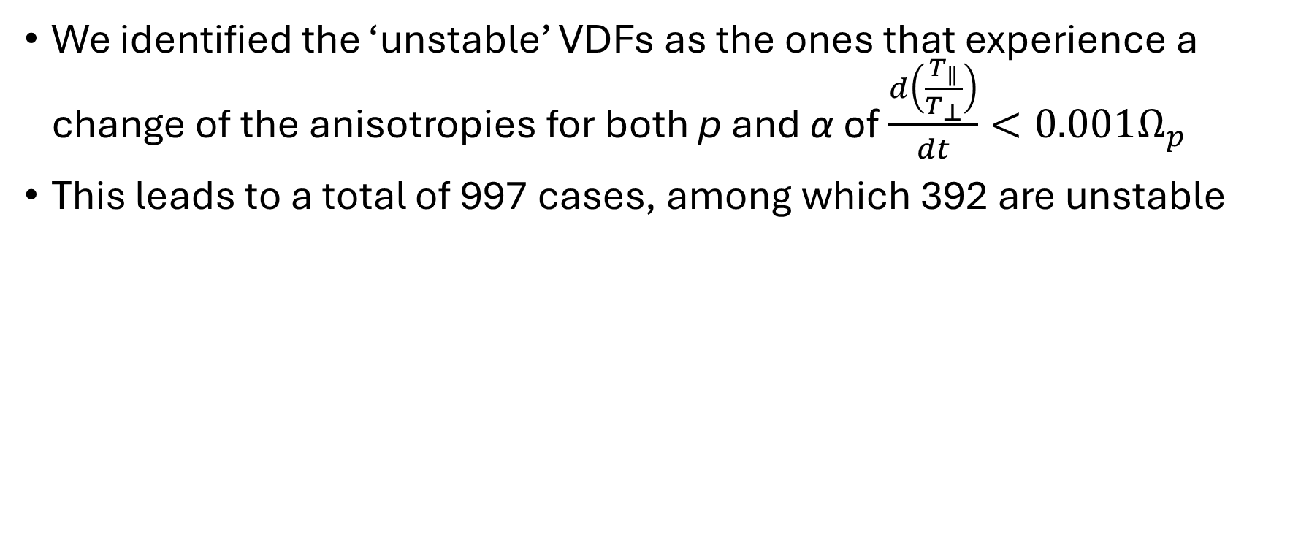
Detection of instabilities. Data Set.
We identified the ‘unstable’ VDFs as the ones that experience a change of the anisotropies for both p and α of $\frac{d\left(\frac{T_{∥}}{T_{⊥}}\right)}{dt}<0.001Ω_{p}$
This leads to a total of 997 cases, among which 392 are unstable
Illustration of the p and α anisotropy evolution for the simulations by Ofman et al. (2023)

Slide 8
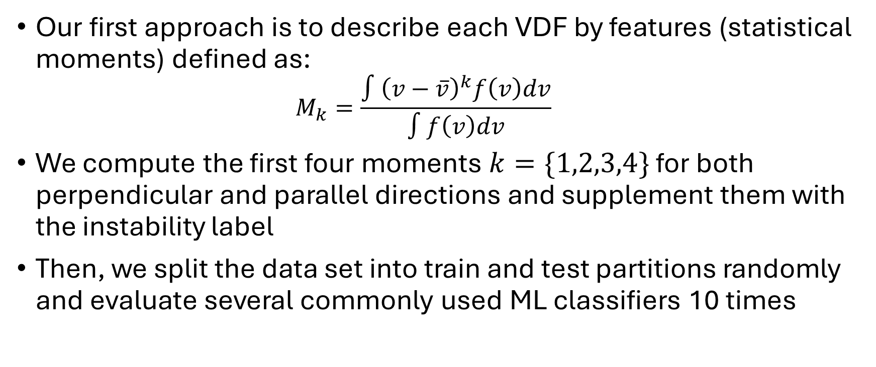
Classification Approach 1. Moments.
Our first approach is to describe each VDF by features (statistical moments) defined as:
$$M_{k}=\frac{∫{\left(v−\overline{v}\right)}^{k}f\left(v\right)dv}{∫f\left(v\right)dv}$$
We compute the first four moments $k=\{1,2,3,4\}$ for both perpendicular and parallel directions and supplement them with the instability label
Then, we split the data set into train and test partitions randomly and evaluate several commonly used ML classifiers 10 times

Slide 9
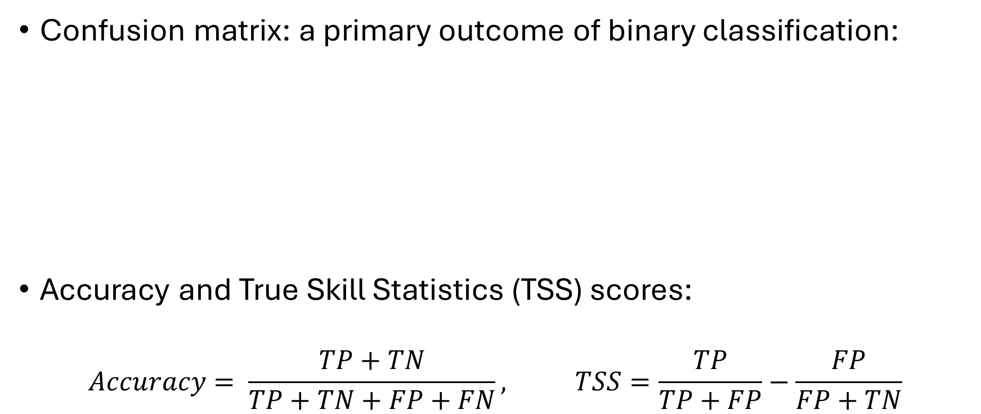
Prediction Assessment
Confusion matrix: a primary outcome of binary classification:
Accuracy and True Skill Statistics (TSS) scores:
$$Accuracy= \frac{TP+TN}{TP+TN+FP+FN}, TSS=\frac{TP}{TP+FP}−\frac{FP}{FP+TN}$$
 | Predicted as stable | Predicted as unstable
Observed as stable | TN | FP
Observed as unstable | FN | TP

Slide 10
Approach 1 Results
ML model | TP | TN | FP | FN | Accuracy | TSS
kNN | 105±7 | 189±6 | 12±3 | 24±7 | 0.89±0.02 | 0.75±0.04
SVM RBF | 111±7 | 169±8 | 32±7 | 18±4 | 0.85±0.02 | 0.70±0.05
MLP (NN) | 113±7 | 189±8 | 12±2 | 16±5 | 0.92±0.02 | 0.82±0.04
Random Forest | 120±7 | 197±7 | 4±3 | 9±3 | 0.96±0.01 | 0.91±0.01
Overall, the results are promising
The results depend on a classifier:
Random Forest with the default settings provides the highest scores
However, we acknowledge that there was no proper hyperparameter tuning implemented so far: the classifiers could demonstrate closer scores after that

Slide 11
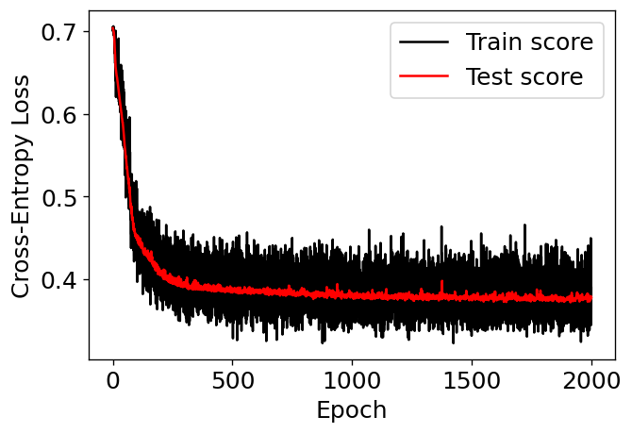
Classification Approach 2. VDFs.
An alternative to feature-based (moment-based) classification are Convolutional Neural Networks (CNNs) applied directly on VDFs.
We have tested two CNNs with two different resolutions of VDFs (0.15V_{A} and 0.10V_{A})
In each case, CNN had three convolution / max pooling layers before the fully-connected part
Training/testing performance was monitored to ensure no overfitting
An example of the CNN training/testing cross-entropy score while it progresses with training

Slide 12
Approach 2 Results
ML model | TP | TN | FP | FN | Accuracy | TSS
kNN | 105±7 | 189±6 | 12±3 | 24±7 | 0.89±0.02 | 0.75±0.04
SVM RBF | 111±7 | 169±8 | 32±7 | 18±4 | 0.85±0.02 | 0.70±0.05
MLP (NN) | 113±7 | 189±8 | 12±2 | 16±5 | 0.92±0.02 | 0.82±0.04
Random Forest | 120±7 | 197±7 | 4±3 | 9±3 | 0.96±0.01 | 0.91±0.01
CNN (0.15V_{A}) | 119±7 | 195±9 | 6±4 | 11±3 | 0.95±0.02 | 0.89±0.03
CNN (0.10V_{A}) | 118±8 | 195±9 | 6±2 | 12±4 | 0.95±0.01 | 0.88±0.03
Results are comparable to Random Forest classifier
Tradeoff between FP/FN could be an important point to select the optimal model

Slide 13
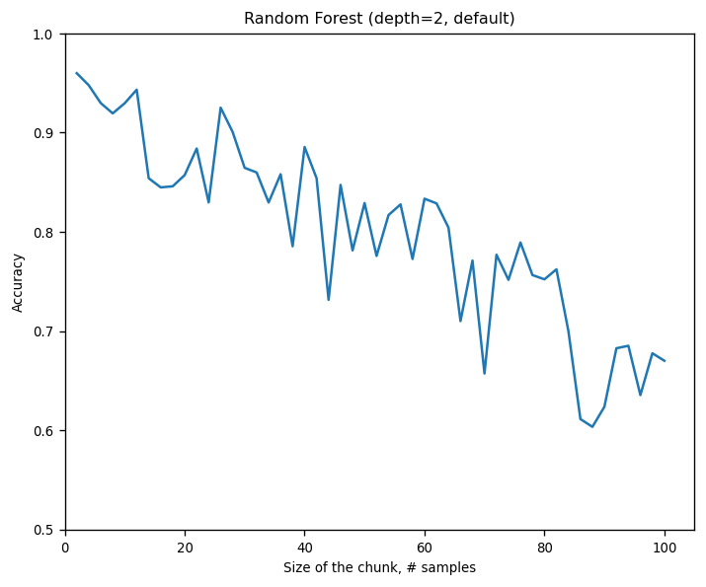
Highlight some problems and ways to resolve
In addition to memorization issues, the known caveat in ML could be in the formation of the data set itself
Temporal coherence (Ahmadzadeh et al. 2021) indicates the closeness of the train/test data set due to random slicing of the temporally-evolving data
Instead of chunking the data randomly, we try to split the data set into larger subsequent packets of VDFs
Accuracy score as a function of the size of the chunk/packet (subsequent VDFs) propagating into each data set (using Random Forest)

Slide 14
Conclusions
We are exploring the potential of the automated identification of instabilities based on Hybrid-PIC simulations and several AI/ML algorithms
16 simulation runs provide in total 997 cases of proton and alpha particle VDFs, among which 392 are assumed as unstable
Both feature-based classification algorithms and Convolutional Neural Networks (CNN) directly applied to VDFs are tested
The initial results are promising:
Feature-based classification based on Random Forest algorithm and CNN result in accuracy of 0.96
However, further investigation is required to avoid temporal coherence problem
Acknowledgements: This research is supported by NSF SHINE grant 2300961

Slide 15
In progress (05/01/2024)

Slide 16
In progress now (05/01/2024)
Siamese networks for classification
Adaptation of input for SAVIC code
[Next] Solving regression problem instead of classification problem
[Next] Writeup/notes preparation

Slide 17
Siamese Networks
Neural Network
(simultaneous weight adjustments)
Predicts similarities and differences between two entries instead of predicting their classes
This effectively pushes the number of training samples from N to N!
A new sample labeling could be done by comparing how close a new sample is to the already-classified samples, on average
Can be used in semi-supervised learning tasks
A limited number of labeled samples is used to train the siamese network and establish a similarity metric
VDF 1
Weight sharing
Similarity measure or label
Comparing Part
Neural Network (simultaneous weight adjustments)
VDF 2

Slide 18
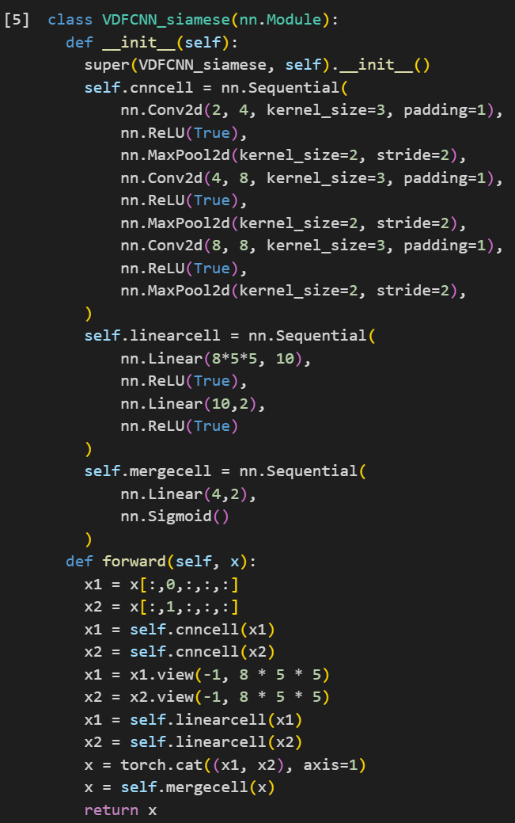
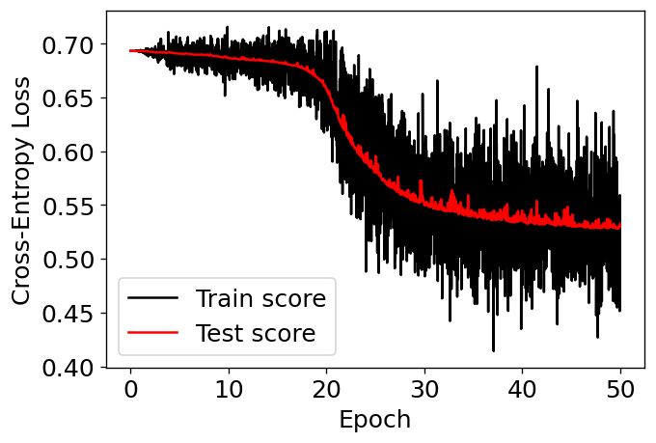
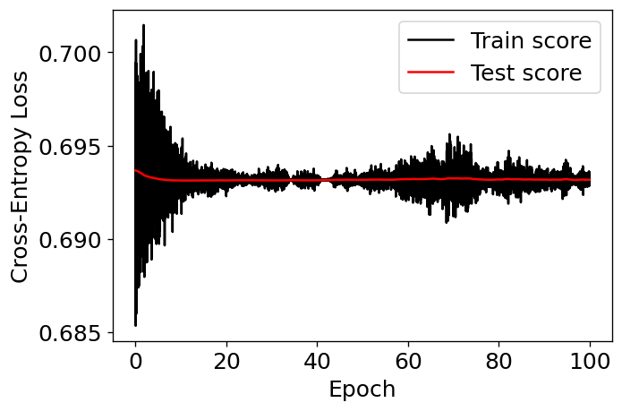
Siamese Networks
Identical network cells: CNNs operating at 0.15V_{A} resolution
Assessing the results so far. The network training seems to be unstable (examples of ‘successful’ and ‘not successful’ training are presented below)

Slide 19
SAVIC code tests
SAVIC examples from the repository were run with no problems (input data sorter and Core – alpha classification models)
Adjusting our input into SAVIC code to cross-compare the ML and SAVIC performances (in progress). It seems that a properly-formatted dataframe is all that needed

Slide 20
Solving a regression problem
Following the discussion with Kris and Leon at TESS meeting, we can try to predict the evolution rates (for the anisotropy, magnetic energy, etc)
Working on the formation of the regression data set now.

Slide 21
In progress (06/05/2024)

Slide 22
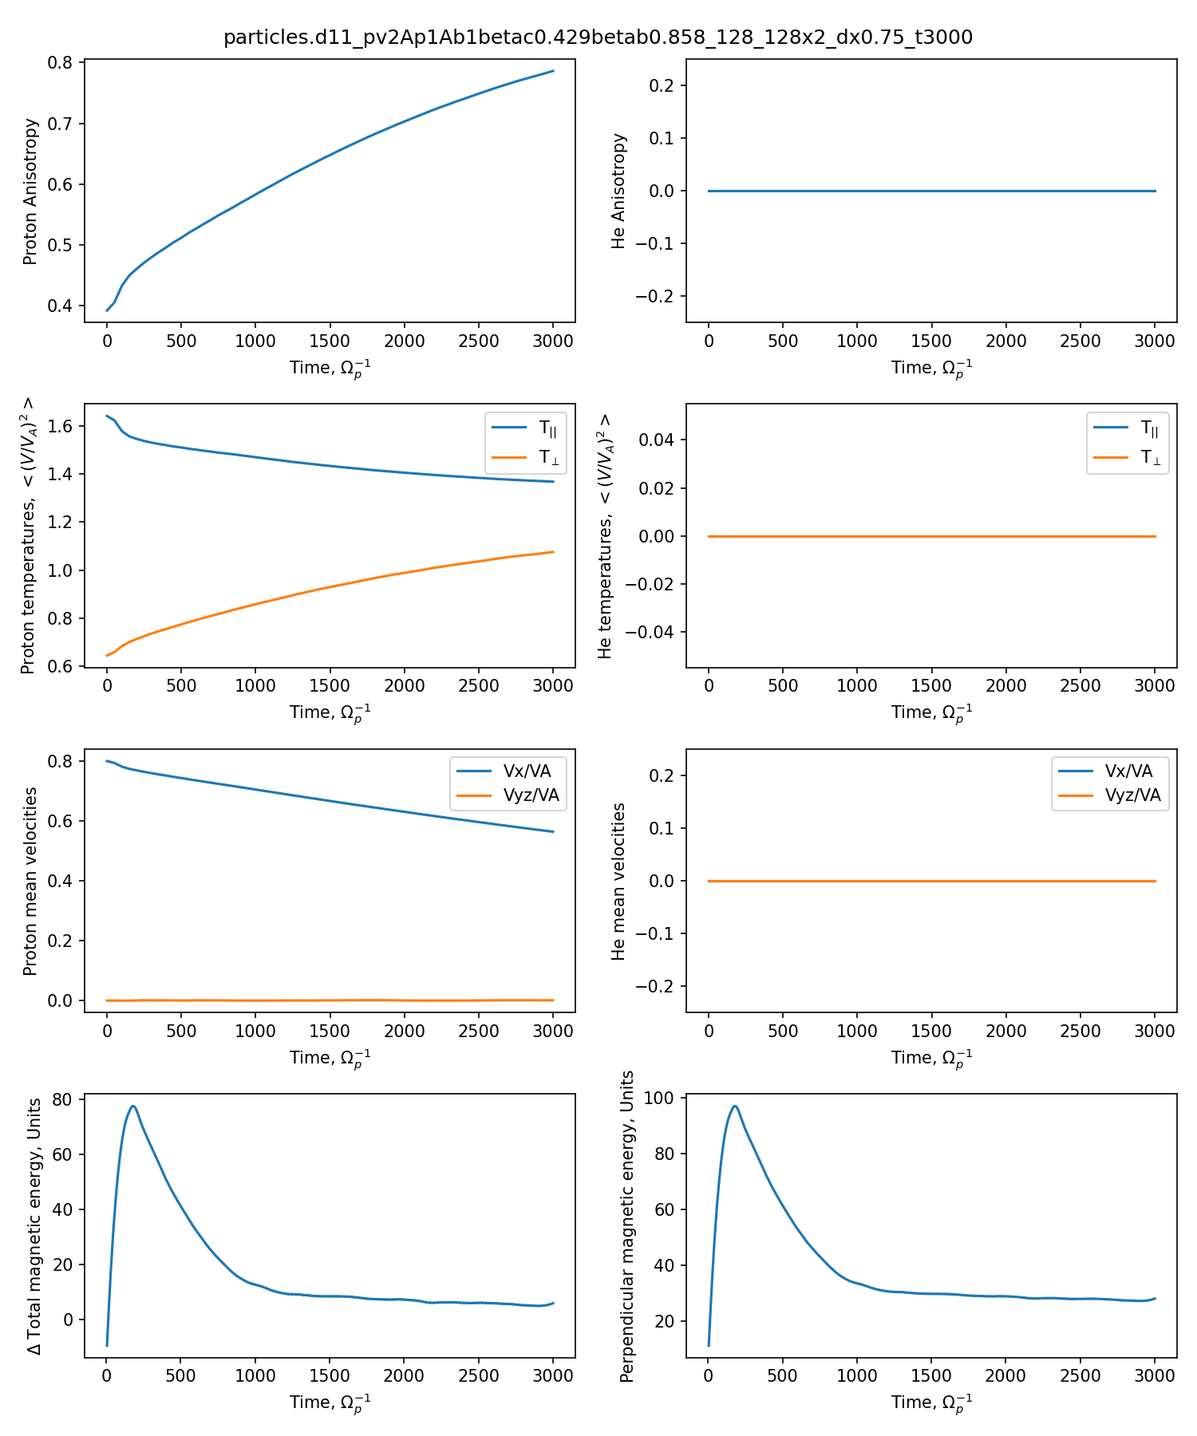
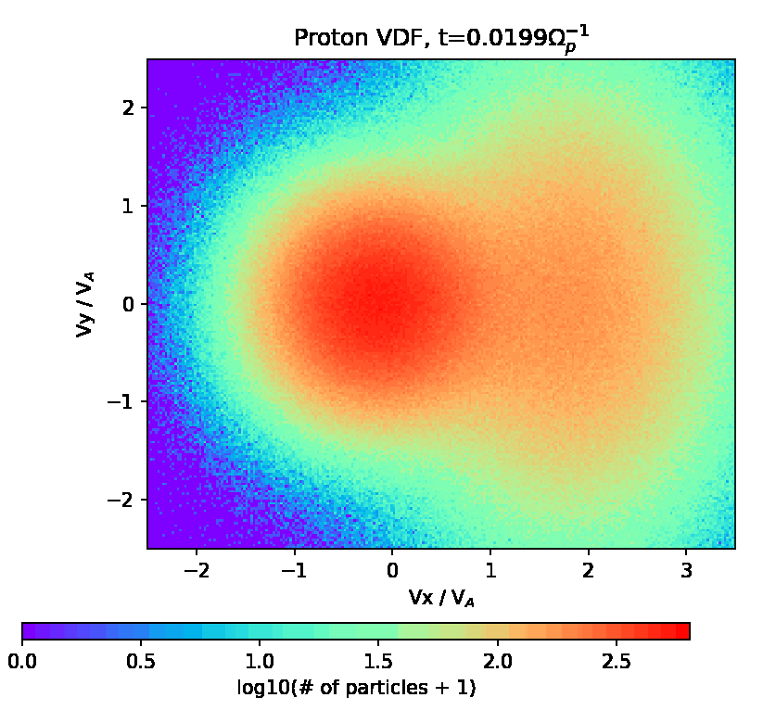
Hot beam runs included in ML

Slide 23
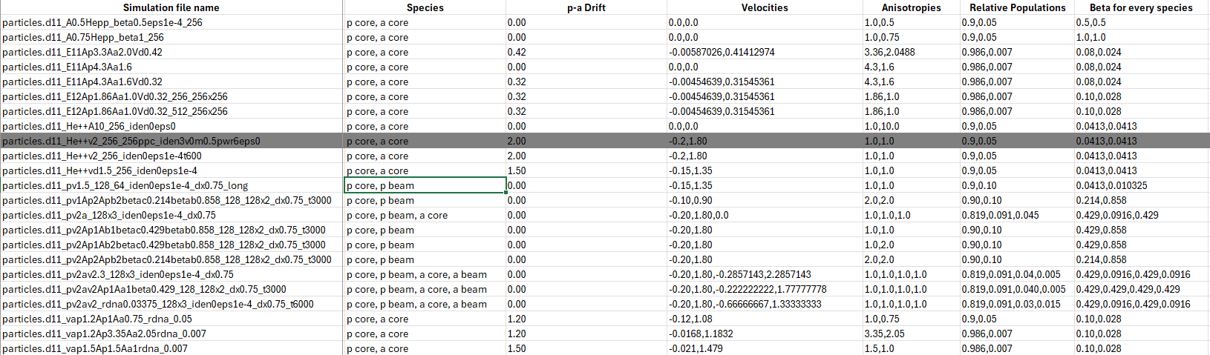
All simulations used for ML

Slide 24
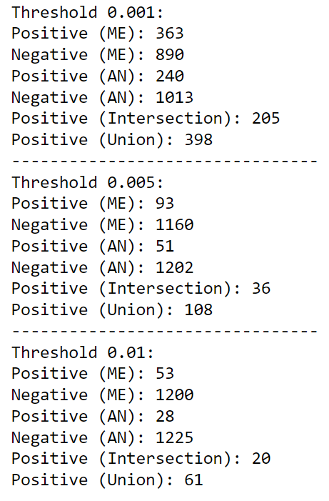
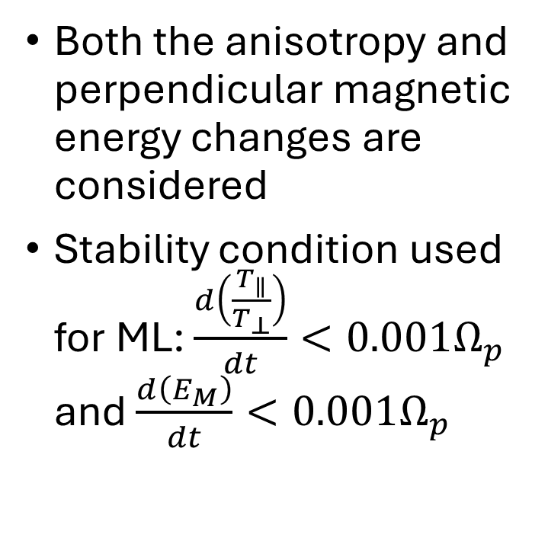
Relabeling of simulations
Both the anisotropy and perpendicular magnetic energy changes are considered
Stability condition used for ML: $\frac{d\left(\frac{T_{∥}}{T_{⊥}}\right)}{dt}<0.001Ω_{p}$ and $\frac{d\left(E_{M}\right)}{dt}<0.001Ω_{p}$

Slide 25
Hyperparameter tuning
Previous attempt:
ML model | TP | TN | FP | FN | Accuracy | TSS
kNN | 105±7 | 189±6 | 12±3 | 24±7 | 0.89±0.02 | 0.75±0.04
SVM RBF | 111±7 | 169±8 | 32±7 | 18±4 | 0.85±0.02 | 0.70±0.05
MLP (NN) | 113±7 | 189±8 | 12±2 | 16±5 | 0.92±0.02 | 0.82±0.04
Random Forest | 120±7 | 197±7 | 4±3 | 9±3 | 0.96±0.01 | 0.91±0.01
Now:
ML model | TP | TN | FP | FN | Accuracy | TSS
kNN | 107±7 | 269±9 | 13±5 | 26±4 | 0.91±0.01 | 0.76±0.03
SVM RBF | 114±7 | 268±9 | 14±4 | 18±5 | 0.92±0.01 | 0.81±0.03
MLP (NN) | 109±8 | 270±8 | 12±4 | 23±4 | 0.91±0.01 | 0.78±0.03
Random Forest | 122±7 | 276±8 | 6±2 | 10±2 | 0.96±0.01 | 0.90±0.01
Note: the data set had changed from the previous to the current effort

Slide 26
Prediction of runs ‘excluded’ for training
Experiment setting:
Select the run #1
Move all the samples from this run into the test data set
Move the samples from all other runs into the train data set
Train the models using the optimal hyperparameter setting on train data set, run the models on the test data set. Obtain the scores.
Empty train/test data sets, return to point 1, select the next run, repeat.
Results are summarized as average accuracy over the excluded run trials, and graphically as a bar chart
Reason: to see how the model behaves on the completely ‘unseen’ sample

Slide 27
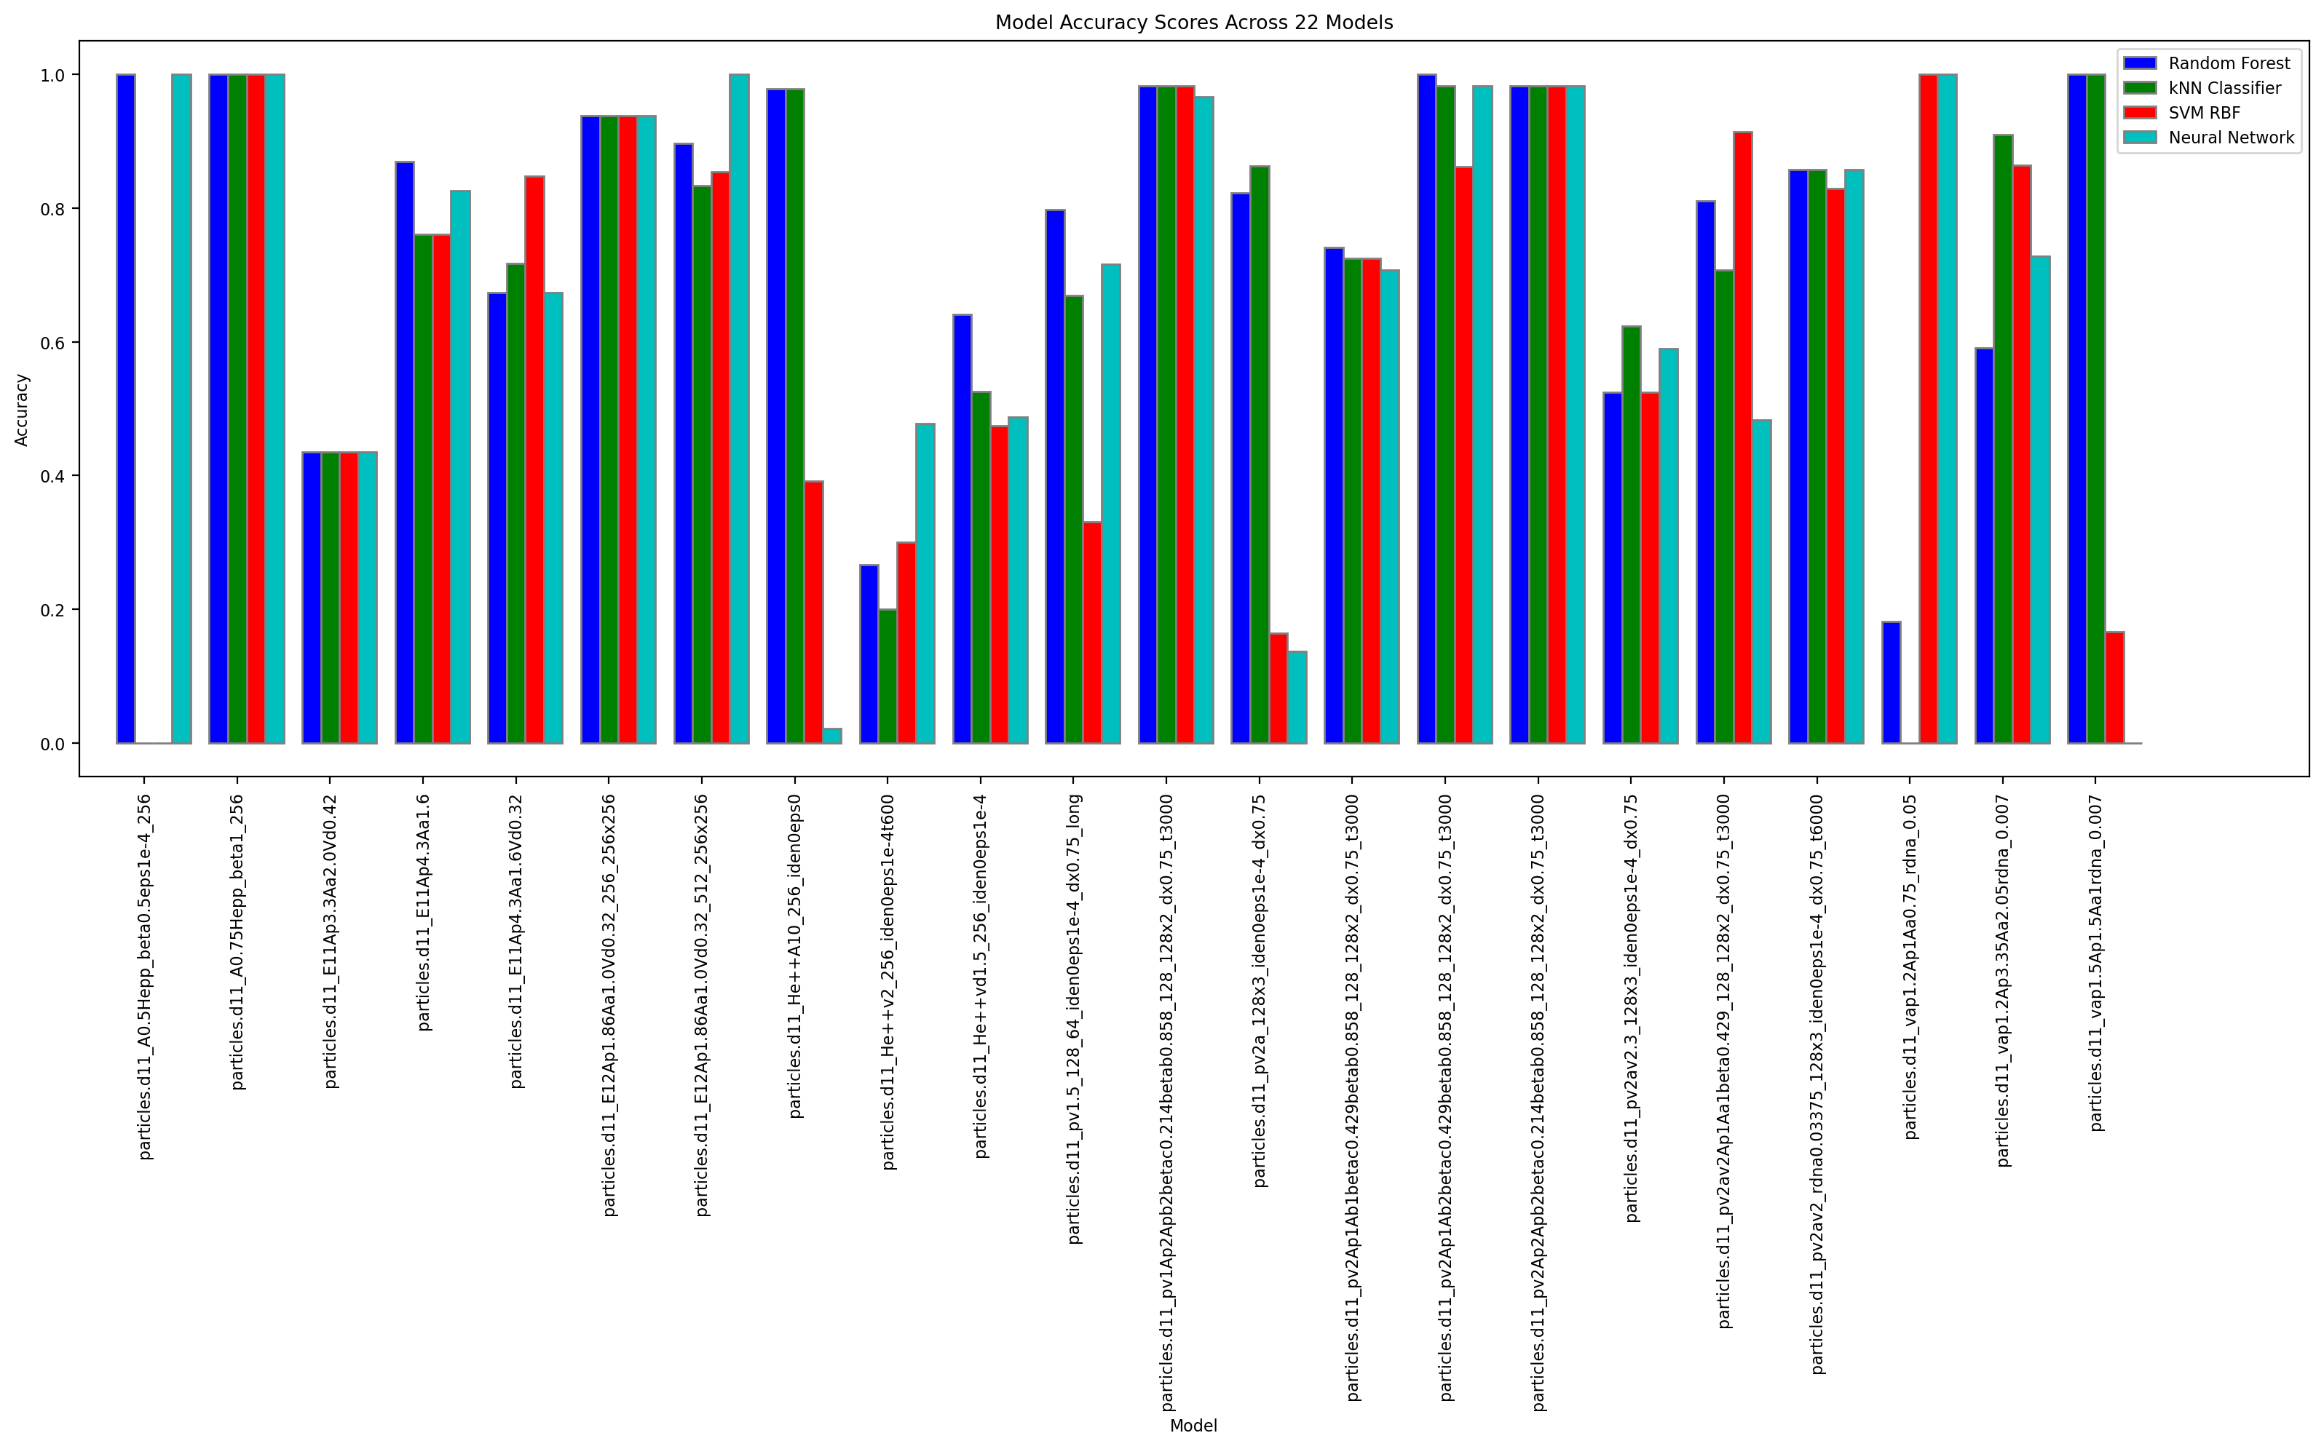

Slide 28
Performance on ‘excluded’ runs
ML model | Accuracy
kNN | 0.71±0.30
SVM RBF | 0.65±0.31
MLP (NN) | 0.68±0.31
Random Forest | 0.77±0.23
Compare to: random train-test splitting
ML model | TP | TN | FP | FN | Accuracy | TSS
kNN | 107±7 | 269±9 | 13±5 | 26±4 | 0.91±0.01 | 0.76±0.03
SVM RBF | 114±7 | 268±9 | 14±4 | 18±5 | 0.92±0.01 | 0.81±0.03
MLP (NN) | 109±8 | 270±8 | 12±4 | 23±4 | 0.91±0.01 | 0.78±0.03
Random Forest | 122±7 | 276±8 | 6±2 | 10±2 | 0.96±0.01 | 0.90±0.01

Slide 29
ADASYN oversampling
ADASYN (about x2, balanced)
ML model | Accuracy
kNN | 0.69±0.29
SVM RBF | 0.63±0.31
MLP (NN) | 0.68±0.31
Random Forest | 0.71±0.29
No oversampling
ML model | Accuracy
kNN | 0.71±0.30
SVM RBF | 0.65±0.31
MLP (NN) | 0.68±0.31
Random Forest | 0.77±0.23
ADASYN (about x2, balanced, 10 neighbors)
ML model | Accuracy
kNN | 0.70±0.29
SVM RBF | 0.62±0.31
MLP (NN) | 0.68±0.31
Random Forest | 0.71±0.27
Not promising so far.

Slide 30
In progress (07/03/2024)

Slide 31
Hot beam runs included in ML

Slide 32
All simulations used for ML

Slide 33
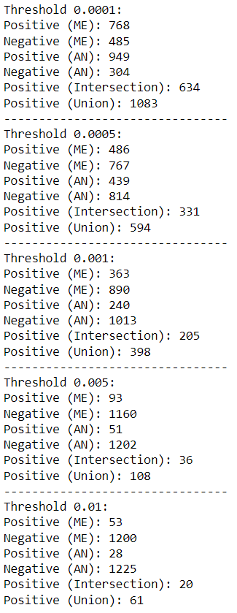
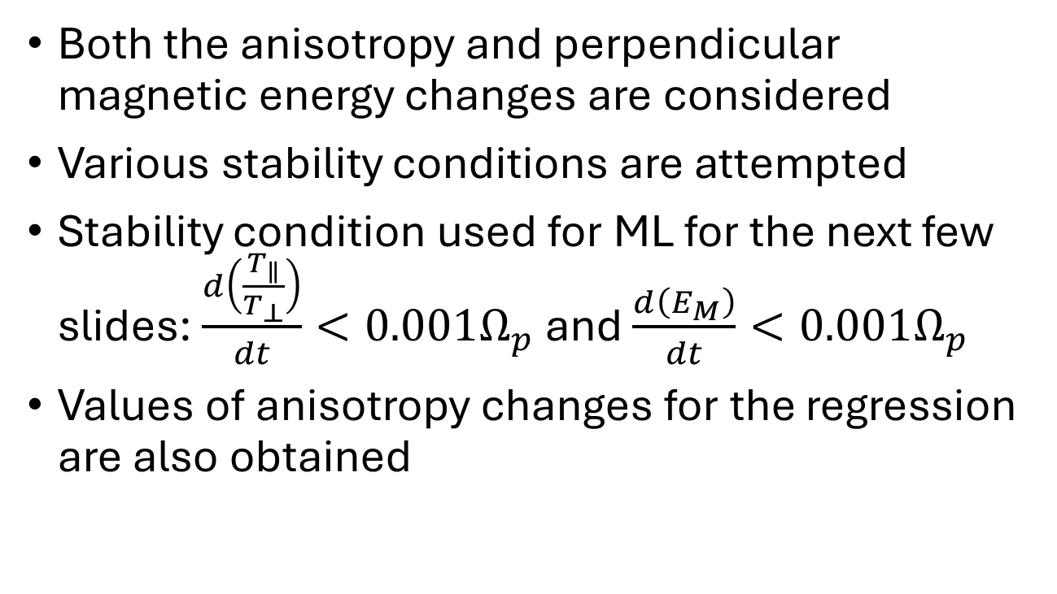
Relabeling of simulations
Both the anisotropy and perpendicular magnetic energy changes are considered
Various stability conditions are attempted
Stability condition used for ML for the next few slides: $\frac{d\left(\frac{T_{∥}}{T_{⊥}}\right)}{dt}<0.001Ω_{p}$ and $\frac{d\left(E_{M}\right)}{dt}<0.001Ω_{p}$
Values of anisotropy changes for the regression are also obtained

Slide 34
Hyperparameter tuning
Previous attempt:
ML model | TP | TN | FP | FN | Accuracy | TSS
kNN | 105±7 | 189±6 | 12±3 | 24±7 | 0.89±0.02 | 0.75±0.04
SVM RBF | 111±7 | 169±8 | 32±7 | 18±4 | 0.85±0.02 | 0.70±0.05
MLP (NN) | 113±7 | 189±8 | 12±2 | 16±5 | 0.92±0.02 | 0.82±0.04
Random Forest | 120±7 | 197±7 | 4±3 | 9±3 | 0.96±0.01 | 0.91±0.01
Now:
ML model | TP | TN | FP | FN | Accuracy | TSS
kNN | 107±7 | 269±9 | 13±5 | 26±4 | 0.91±0.01 | 0.76±0.03
SVM RBF | 114±7 | 268±9 | 14±4 | 18±5 | 0.92±0.01 | 0.81±0.03
MLP (NN) | 109±8 | 270±8 | 12±4 | 23±4 | 0.91±0.01 | 0.78±0.03
Random Forest | 122±7 | 276±8 | 6±2 | 10±2 | 0.96±0.01 | 0.90±0.01
Note: the data set had changed from the previous to the current effort

Slide 35
Prediction of runs ‘excluded’ for training
Experiment setting:
Select the run #1
Move all the samples from this run into the test data set
Move the samples from all other runs into the train data set
Train the models using the optimal hyperparameter setting on train data set, run the models on the test data set. Obtain the scores.
Empty train/test data sets, return to point 1, select the next run, repeat.
Results are summarized as average accuracy over the excluded run trials, and graphically as a bar chart
Reason: to see how the model behaves on the completely ‘unseen’ sample

Slide 37
Performance on ‘excluded’ runs
ML model | Accuracy
kNN | 0.71±0.30
SVM RBF | 0.65±0.31
MLP (NN) | 0.68±0.31
Random Forest | 0.77±0.23
Compare to: random train-test splitting
ML model | TP | TN | FP | FN | Accuracy | TSS
kNN | 107±7 | 269±9 | 13±5 | 26±4 | 0.91±0.01 | 0.76±0.03
SVM RBF | 114±7 | 268±9 | 14±4 | 18±5 | 0.92±0.01 | 0.81±0.03
MLP (NN) | 109±8 | 270±8 | 12±4 | 23±4 | 0.91±0.01 | 0.78±0.03
Random Forest | 122±7 | 276±8 | 6±2 | 10±2 | 0.96±0.01 | 0.90±0.01

Slide 38
ADASYN oversampling
ADASYN (about x2, balanced)
ML model | Accuracy
kNN | 0.69±0.29
SVM RBF | 0.63±0.31
MLP (NN) | 0.68±0.31
Random Forest | 0.71±0.29
No oversampling
ML model | Accuracy
kNN | 0.71±0.30
SVM RBF | 0.65±0.31
MLP (NN) | 0.68±0.31
Random Forest | 0.77±0.23
ADASYN (about x2, balanced, 10 neighbors)
ML model | Accuracy
kNN | 0.70±0.29
SVM RBF | 0.62±0.31
MLP (NN) | 0.68±0.31
Random Forest | 0.71±0.27
Not promising so far.

Slide 39

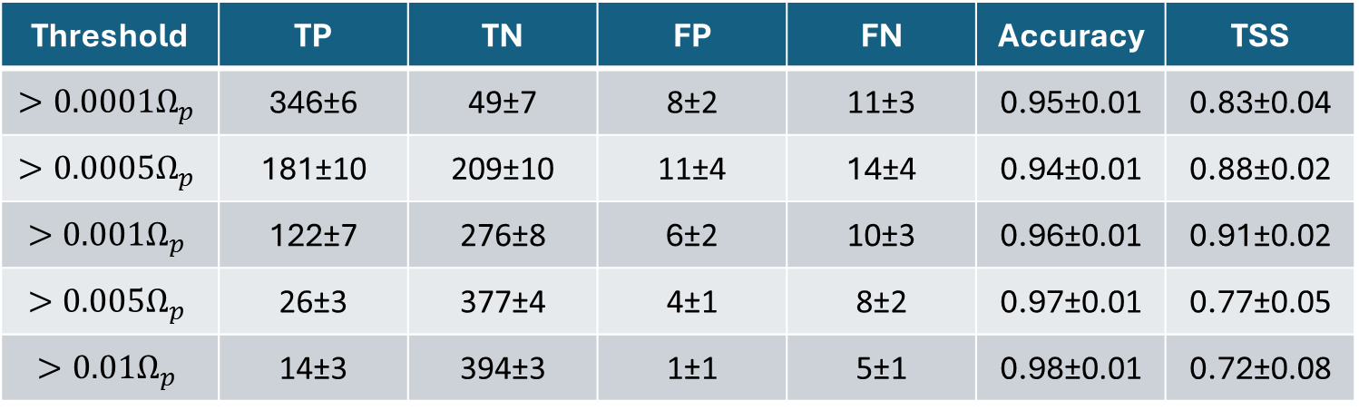
Threshold variations (Random Forest, accuracy)
Threshold | TP | TN | FP | FN | Accuracy | TSS
$$>0.0001Ω_{p}$$ | 346±6 | 49±7 | 8±2 | 11±3 | 0.95±0.01 | 0.83±0.04
$$>0.0005Ω_{p}$$ | 181±10 | 209±10 | 11±4 | 14±4 | 0.94±0.01 | 0.88±0.02
$$>0.001Ω_{p}$$ | 122±7 | 276±8 | 6±2 | 10±3 | 0.96±0.01 | 0.91±0.02
$$>0.005Ω_{p}$$ | 26±3 | 377±4 | 4±1 | 8±2 | 0.97±0.01 | 0.77±0.05
$$>0.01Ω_{p}$$ | 14±3 | 394±3 | 1±1 | 5±1 | 0.98±0.01 | 0.72±0.08
$$Accuracy= \frac{TP+TN}{TP+TN+FP+FN}$$

Slide 40

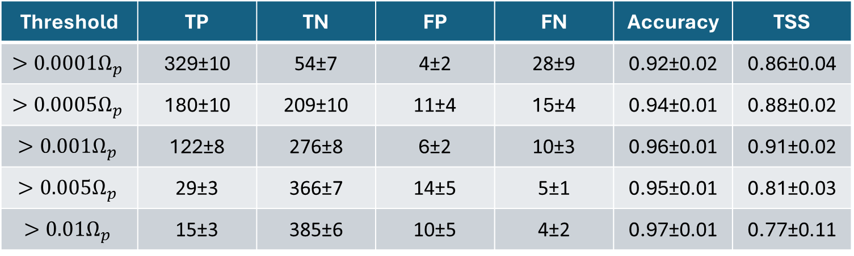
Threshold variations (Random Forest, TSS)
Threshold | TP | TN | FP | FN | Accuracy | TSS
$$>0.0001Ω_{p}$$ | 329±10 | 54±7 | 4±2 | 28±9 | 0.92±0.02 | 0.86±0.04
$$>0.0005Ω_{p}$$ | 180±10 | 209±10 | 11±4 | 15±4 | 0.94±0.01 | 0.88±0.02
$$>0.001Ω_{p}$$ | 122±8 | 276±8 | 6±2 | 10±3 | 0.96±0.01 | 0.91±0.02
$$>0.005Ω_{p}$$ | 29±3 | 366±7 | 14±5 | 5±1 | 0.95±0.01 | 0.81±0.03
$$>0.01Ω_{p}$$ | 15±3 | 385±6 | 10±5 | 4±2 | 0.97±0.01 | 0.77±0.11
$$TSS=\frac{TP}{TP+FP}−\frac{FP}{FP+TN}$$

Slide 41
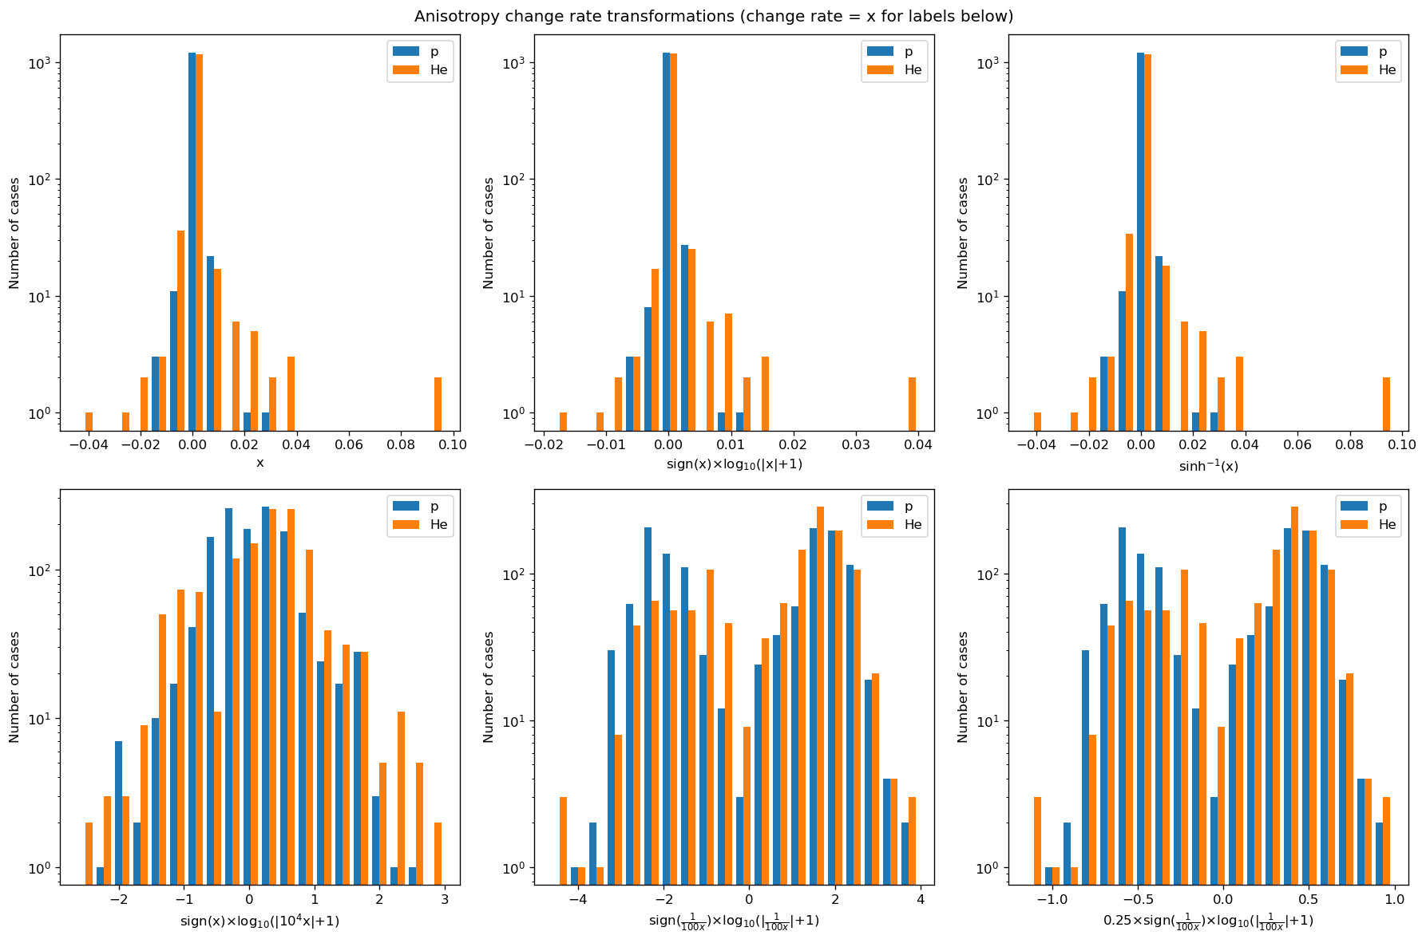
Regression Results: remapping of rates

Slide 42
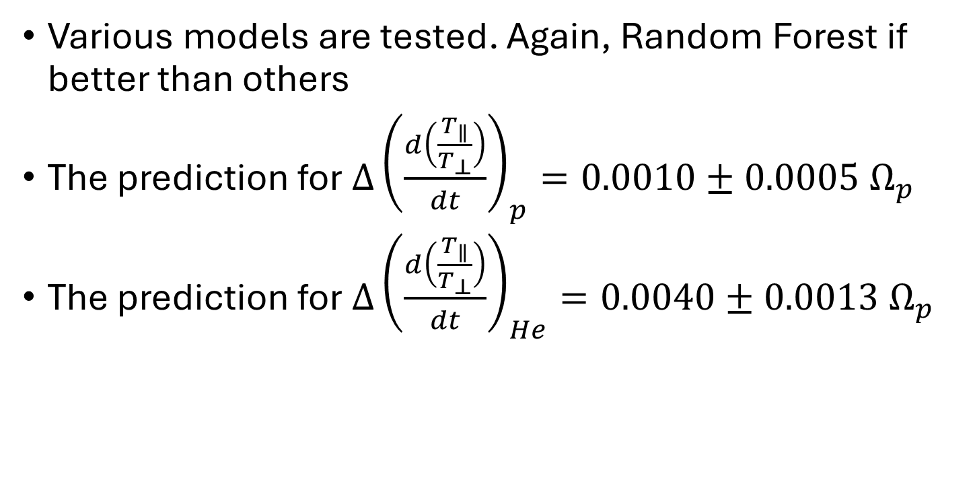
Regression Results
Various models are tested. Again, Random Forest if better than others
The prediction for $Δ{\left(\frac{d\left(\frac{T_{∥}}{T_{⊥}}\right)}{dt}\right)}_{p}=0.0010±0.0005{ Ω}_{p}$
The prediction for $Δ{\left(\frac{d\left(\frac{T_{∥}}{T_{⊥}}\right)}{dt}\right)}_{He}=0.0040±0.0013{ Ω}_{p}$

Slide 43
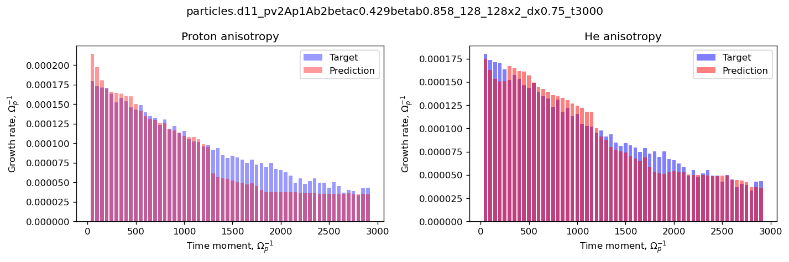
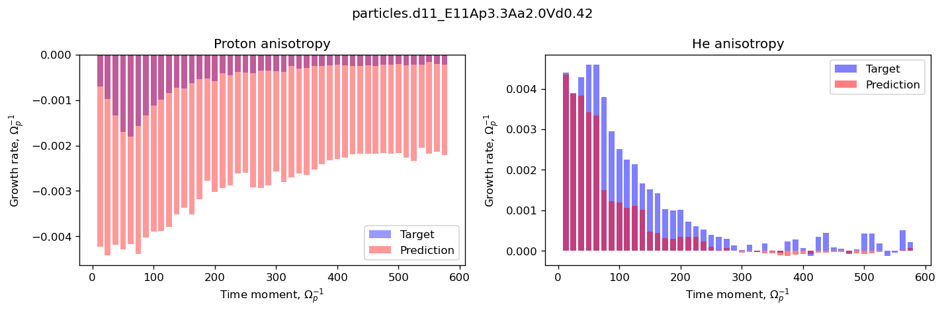
Regression Results: some are relatively good…

Slide 44
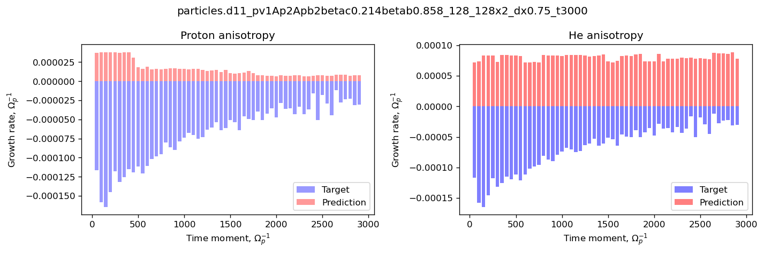
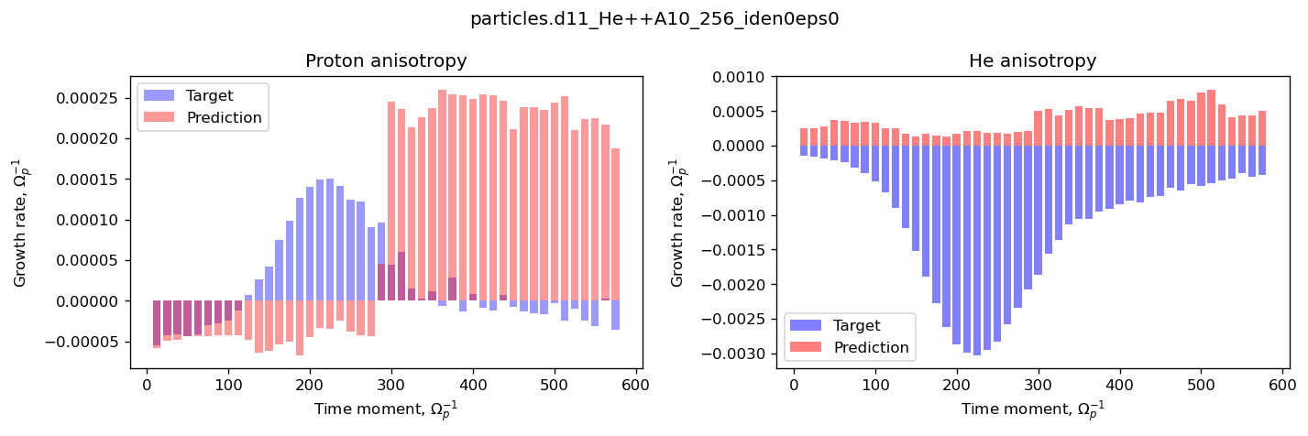
Regression Results: and sometimes not very…

Slide 45
Next steps
Finalize the regression results including the analysis for individual runs (as done for classification)
Implementation of the same pipelines for CNN (not expecting significant differences, but necessary for completeness)
Magnetic field spectra processing for the simulations

Slide 46
In progress (10/31/2024)

Slide 47
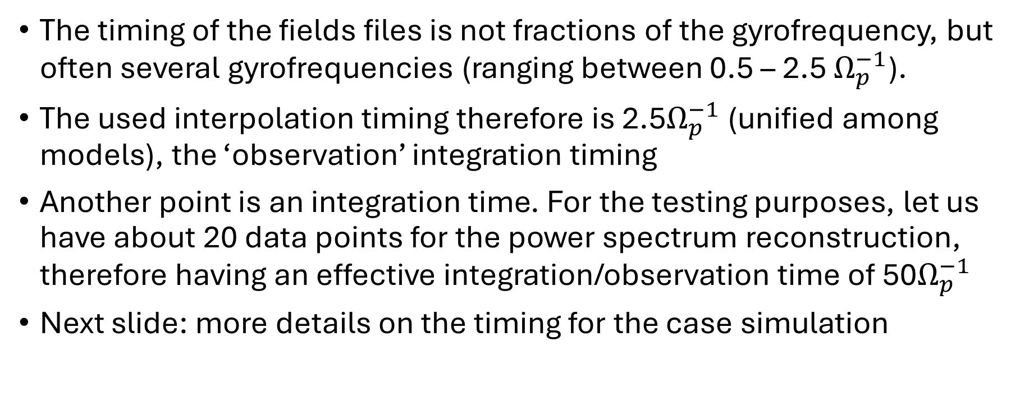
Simulation fields files
The timing of the fields files is not fractions of the gyrofrequency, but often several gyrofrequencies (ranging between 0.5 – 2.5 $Ω_{p}^{−1}$).
The used interpolation timing therefore is 2.5$Ω_{p}^{−1}$ (unified among models), the ‘observation’ integration timing
Another point is an integration time. For the testing purposes, let us have about 20 data points for the power spectrum reconstruction, therefore having an effective integration/observation time of 50$Ω_{p}^{−1}$
Next slide: more details on the timing for the case simulation

Slide 48
Detailed timing
vvvvvvvvvvvvvvvvvvvvvvvvvvvvvvvvvvvvvvvvvvvvvvvvvvvvvvvvvvvv
-> SIMULATION: ./fields.d10_A0.5Hepp_beta0.5eps1e-4_256
^^^^^^^^^^^^^^^^^^^^^^^^^^^^^^^^^^^^^^^^^^^^^^^^^^^^^^^^^^^^
Time step in proton gyroperiods : 2.5
vvvvvvvvvvvvvvvvvvvvvvvvvvvvvvvvvvvvvvvvvvvvvvvvvvvvvvvvvvvv
-> SIMULATION: ./fields.d10_A0.75Hepp_beta1_256
^^^^^^^^^^^^^^^^^^^^^^^^^^^^^^^^^^^^^^^^^^^^^^^^^^^^^^^^^^^^
Time step in proton gyroperiods : 2.5
vvvvvvvvvvvvvvvvvvvvvvvvvvvvvvvvvvvvvvvvvvvvvvvvvvvvvvvvvvvv
-> SIMULATION: ./fields.d10_E11Ap3.3Aa2.0Vd0.42
^^^^^^^^^^^^^^^^^^^^^^^^^^^^^^^^^^^^^^^^^^^^^^^^^^^^^^^^^^^^
Time step in proton gyroperiods : 1.25
vvvvvvvvvvvvvvvvvvvvvvvvvvvvvvvvvvvvvvvvvvvvvvvvvvvvvvvvvvvv
-> SIMULATION: ./fields.d10_E11Ap4.3Aa1.6
^^^^^^^^^^^^^^^^^^^^^^^^^^^^^^^^^^^^^^^^^^^^^^^^^^^^^^^^^^^^
Time step in proton gyroperiods : 1.25
vvvvvvvvvvvvvvvvvvvvvvvvvvvvvvvvvvvvvvvvvvvvvvvvvvvvvvvvvvvv
-> SIMULATION: ./fields.d10_E11Ap4.3Aa1.6Vd0.32
^^^^^^^^^^^^^^^^^^^^^^^^^^^^^^^^^^^^^^^^^^^^^^^^^^^^^^^^^^^^
Time step in proton gyroperiods : 1.25
vvvvvvvvvvvvvvvvvvvvvvvvvvvvvvvvvvvvvvvvvvvvvvvvvvvvvvvvvvvv
-> SIMULATION: ./fields.d10_E12Ap1.86Aa1.0Vd0.32_256_256x256
^^^^^^^^^^^^^^^^^^^^^^^^^^^^^^^^^^^^^^^^^^^^^^^^^^^^^^^^^^^^
Time step in proton gyroperiods : 2.5
vvvvvvvvvvvvvvvvvvvvvvvvvvvvvvvvvvvvvvvvvvvvvvvvvvvvvvvvvvvv
-> SIMULATION: ./fields.d10_E12Ap1.86Aa1.0Vd0.32_512_256x256
^^^^^^^^^^^^^^^^^^^^^^^^^^^^^^^^^^^^^^^^^^^^^^^^^^^^^^^^^^^^
Time step in proton gyroperiods : 2.5
vvvvvvvvvvvvvvvvvvvvvvvvvvvvvvvvvvvvvvvvvvvvvvvvvvvvvvvvvvvv
-> SIMULATION: ./fields.d10_He++A10_256_iden0eps0
^^^^^^^^^^^^^^^^^^^^^^^^^^^^^^^^^^^^^^^^^^^^^^^^^^^^^^^^^^^^
Time step in proton gyroperiods : 1.25
vvvvvvvvvvvvvvvvvvvvvvvvvvvvvvvvvvvvvvvvvvvvvvvvvvvvvvvvvvvv
-> SIMULATION: ./fields.d10_He++v2_256_iden0eps1e-4t600
^^^^^^^^^^^^^^^^^^^^^^^^^^^^^^^^^^^^^^^^^^^^^^^^^^^^^^^^^^^^
Time step in proton gyroperiods : 0.5
vvvvvvvvvvvvvvvvvvvvvvvvvvvvvvvvvvvvvvvvvvvvvvvvvvvvvvvvvvvv
-> SIMULATION: ./fields.d10_He++vd1.5_256_iden0eps1e-4
^^^^^^^^^^^^^^^^^^^^^^^^^^^^^^^^^^^^^^^^^^^^^^^^^^^^^^^^^^^^
Time step in proton gyroperiods : 1.25
vvvvvvvvvvvvvvvvvvvvvvvvvvvvvvvvvvvvvvvvvvvvvvvvvvvvvvvvvvvv
-> SIMULATION: ./fields.d10_pv1.5_128_64_iden0eps1e-4_dx0.75_long
^^^^^^^^^^^^^^^^^^^^^^^^^^^^^^^^^^^^^^^^^^^^^^^^^^^^^^^^^^^^
Time step in proton gyroperiods : 1.0
vvvvvvvvvvvvvvvvvvvvvvvvvvvvvvvvvvvvvvvvvvvvvvvvvvvvvvvvvvvv
-> SIMULATION: ./fields.d10_pv1Ap2Apb2betac0.214betab0.858_128_128x2_dx0.75_t3000
^^^^^^^^^^^^^^^^^^^^^^^^^^^^^^^^^^^^^^^^^^^^^^^^^^^^^^^^^^^^
Time step in proton gyroperiods : 1.0
vvvvvvvvvvvvvvvvvvvvvvvvvvvvvvvvvvvvvvvvvvvvvvvvvvvvvvvvvvvv
-> SIMULATION: ./fields.d10_pv2a_128x3_iden0eps1e-4_dx0.75
^^^^^^^^^^^^^^^^^^^^^^^^^^^^^^^^^^^^^^^^^^^^^^^^^^^^^^^^^^^^
Time step in proton gyroperiods : 1.0
vvvvvvvvvvvvvvvvvvvvvvvvvvvvvvvvvvvvvvvvvvvvvvvvvvvvvvvvvvvv
-> SIMULATION: ./fields.d10_pv2Ap1Ab1betac0.429betab0.858_128_128x2_dx0.75_t3000
^^^^^^^^^^^^^^^^^^^^^^^^^^^^^^^^^^^^^^^^^^^^^^^^^^^^^^^^^^^^
Time step in proton gyroperiods : 1.0
vvvvvvvvvvvvvvvvvvvvvvvvvvvvvvvvvvvvvvvvvvvvvvvvvvvvvvvvvvvv
-> SIMULATION: ./fields.d10_pv2Ap1Ab2betac0.429betab0.858_128_128x2_dx0.75_t3000
^^^^^^^^^^^^^^^^^^^^^^^^^^^^^^^^^^^^^^^^^^^^^^^^^^^^^^^^^^^^
Time step in proton gyroperiods : 1.0
vvvvvvvvvvvvvvvvvvvvvvvvvvvvvvvvvvvvvvvvvvvvvvvvvvvvvvvvvvvv
-> SIMULATION: ./fields.d10_pv2Ap2Apb2betac0.214betab0.858_128_128x2_dx0.75_t3000
^^^^^^^^^^^^^^^^^^^^^^^^^^^^^^^^^^^^^^^^^^^^^^^^^^^^^^^^^^^^
Time step in proton gyroperiods : 1.0
vvvvvvvvvvvvvvvvvvvvvvvvvvvvvvvvvvvvvvvvvvvvvvvvvvvvvvvvvvvv
-> SIMULATION: ./fields.d10_pv2av2.3_128x3_iden0eps1e-4_dx0.75
^^^^^^^^^^^^^^^^^^^^^^^^^^^^^^^^^^^^^^^^^^^^^^^^^^^^^^^^^^^^
Time step in proton gyroperiods : 1.0
vvvvvvvvvvvvvvvvvvvvvvvvvvvvvvvvvvvvvvvvvvvvvvvvvvvvvvvvvvvv
-> SIMULATION: ./fields.d10_pv2av2Ap1Aa1beta0.429_128_128x2_dx0.75_t3000
^^^^^^^^^^^^^^^^^^^^^^^^^^^^^^^^^^^^^^^^^^^^^^^^^^^^^^^^^^^^
Time step in proton gyroperiods : 1.0
vvvvvvvvvvvvvvvvvvvvvvvvvvvvvvvvvvvvvvvvvvvvvvvvvvvvvvvvvvvv
-> SIMULATION: ./fields.d10_pv2av2_rdna0.03375_128x3_iden0eps1e-4_dx0.75_t6000
^^^^^^^^^^^^^^^^^^^^^^^^^^^^^^^^^^^^^^^^^^^^^^^^^^^^^^^^^^^^
Time step in proton gyroperiods : 1.0
vvvvvvvvvvvvvvvvvvvvvvvvvvvvvvvvvvvvvvvvvvvvvvvvvvvvvvvvvvvv
-> SIMULATION: ./fields.d10_vap1.2Ap1Aa0.75_rdna_0.05
^^^^^^^^^^^^^^^^^^^^^^^^^^^^^^^^^^^^^^^^^^^^^^^^^^^^^^^^^^^^
Time step in proton gyroperiods : 2.5
vvvvvvvvvvvvvvvvvvvvvvvvvvvvvvvvvvvvvvvvvvvvvvvvvvvvvvvvvvvv
-> SIMULATION: ./fields.d10_vap1.2Ap3.35Aa2.05rdna_0.007
^^^^^^^^^^^^^^^^^^^^^^^^^^^^^^^^^^^^^^^^^^^^^^^^^^^^^^^^^^^^
Time step in proton gyroperiods : 2.5
vvvvvvvvvvvvvvvvvvvvvvvvvvvvvvvvvvvvvvvvvvvvvvvvvvvvvvvvvvvv
-> SIMULATION: ./fields.d10_vap1.5Ap1.5Aa1rdna_0.007
^^^^^^^^^^^^^^^^^^^^^^^^^^^^^^^^^^^^^^^^^^^^^^^^^^^^^^^^^^^^
Time step in proton gyroperiods : 2.5

Slide 49
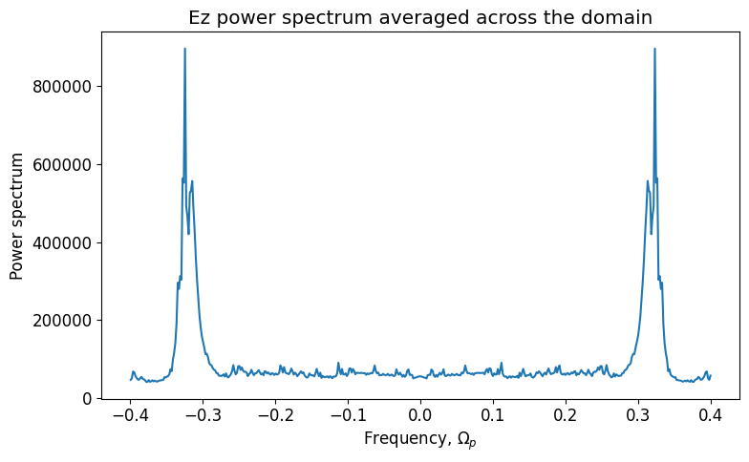
fields.d10_E11Ap4.3Aa1.6Vd0.32
E_perp
0 ~f_p

Slide 50
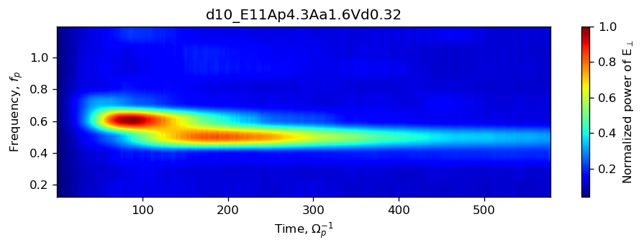
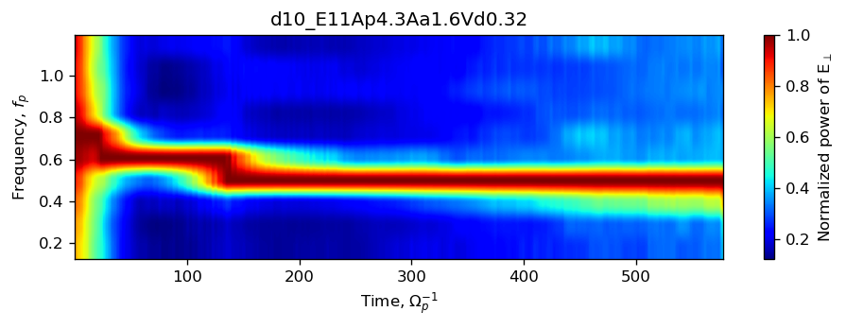
fields.d10_E11Ap4.3Aa1.6Vd0.32: spectra
Normalized: entire domain
Normalized: per time step

Slide 51
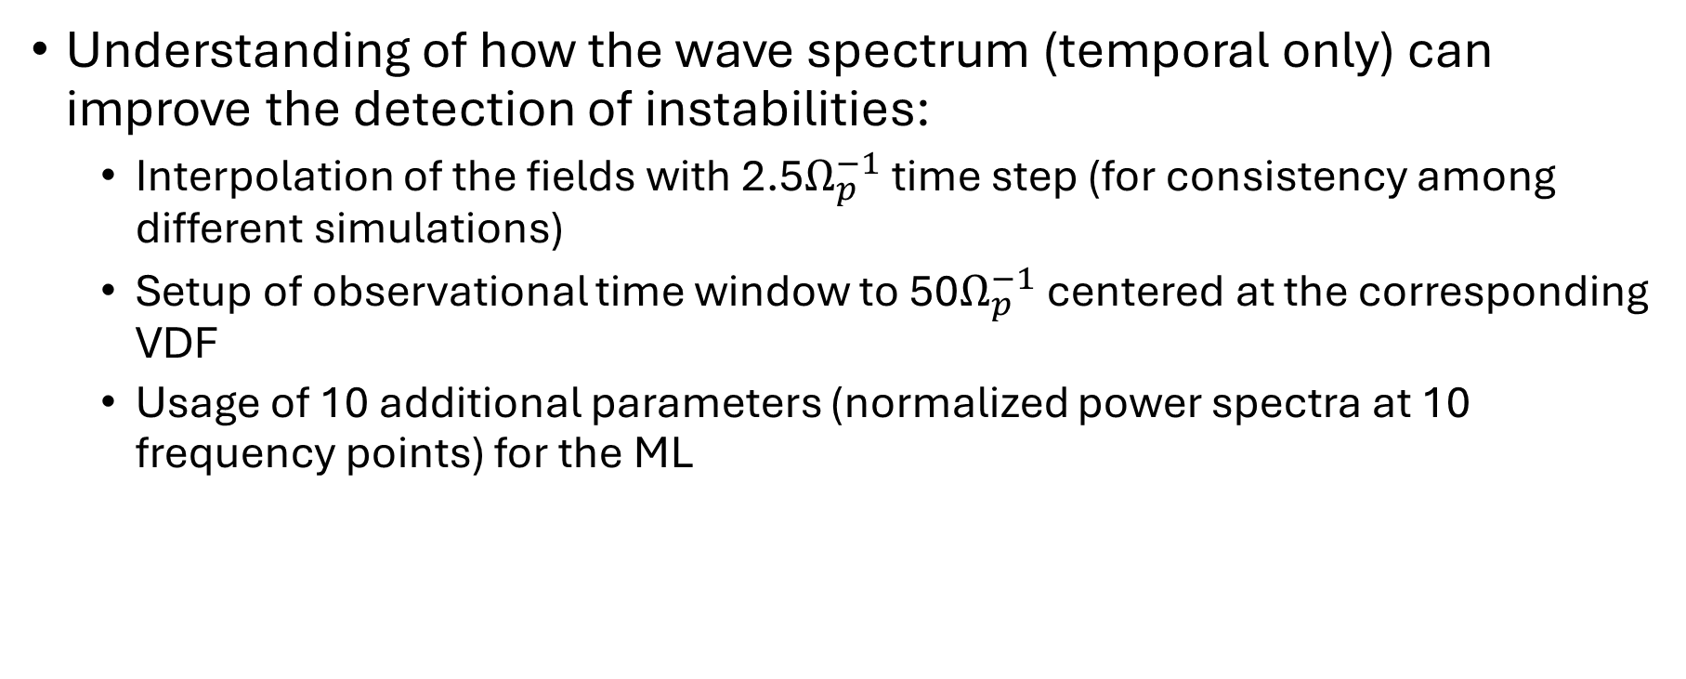
Testing power spectrum
Understanding of how the wave spectrum (temporal only) can improve the detection of instabilities:
Interpolation of the fields with 2.5$Ω_{p}^{−1}$ time step (for consistency among different simulations)
Setup of observational time window to 50$Ω_{p}^{−1}$ centered at the corresponding VDF
Usage of 10 additional parameters (normalized power spectra at 10 frequency points) for the ML

Slide 52
Testing power spectrum
No spectrum:
ML model | TP | TN | FP | FN | Accuracy | TSS
kNN | 107±7 | 269±9 | 13±5 | 26±4 | 0.91±0.01 | 0.76±0.03
SVM RBF | 114±7 | 268±9 | 14±4 | 18±5 | 0.92±0.01 | 0.81±0.03
MLP (NN) | 109±8 | 270±8 | 12±4 | 23±4 | 0.91±0.01 | 0.78±0.03
Random Forest | 122±7 | 276±8 | 6±2 | 10±2 | 0.96±0.01 | 0.90±0.01
With spectrum:
ML model | TP | TN | FP | FN | Accuracy | TSS
kNN | 107±7 | 277±8 | 5±2 | 25±3 | 0.93±0.01 | 0.79±0.02
SVM RBF | 119±8 | 271±8 | 11±2 | 13±3 | 0.94±0.01 | 0.86±0.02
MLP (NN) | 116±8 | 268±8 | 14±4 | 16±3 | 0.93±0.01 | 0.83±0.01
Random Forest | 121±8 | 276±8 | 6±2 | 11±2 | 0.96±0.01 | 0.89±0.02

Slide 53
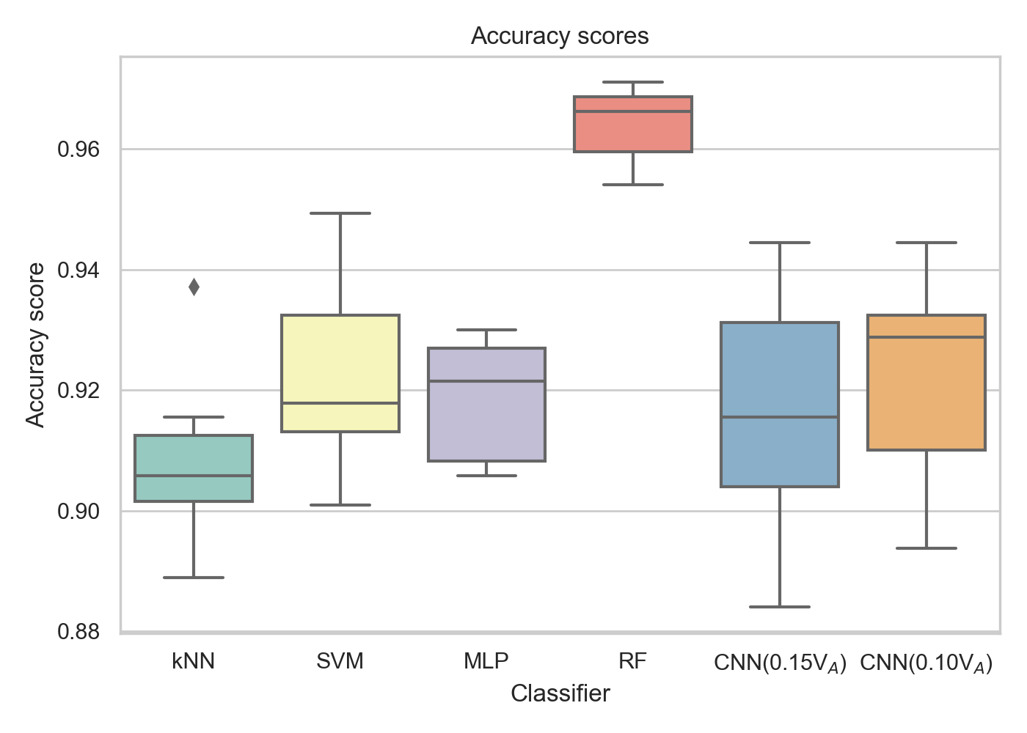
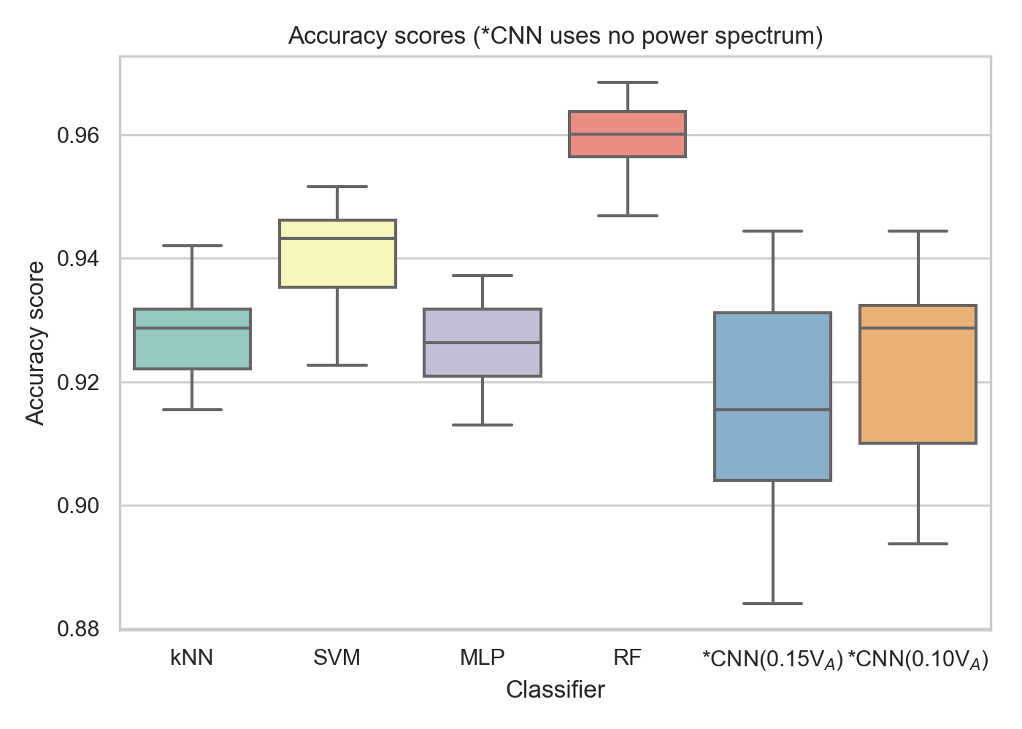
Testing power spectrum
No power spectrum
With power spectrum

Slide 54
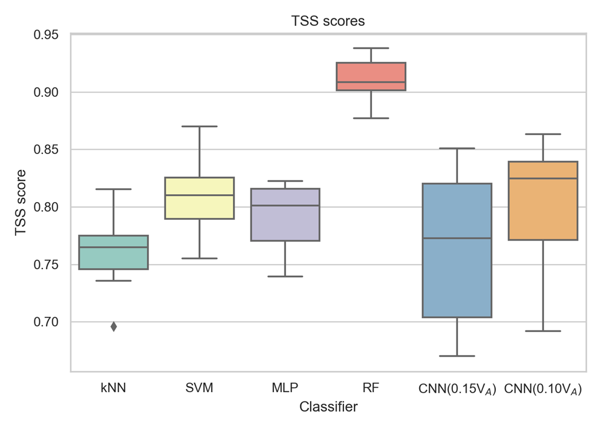
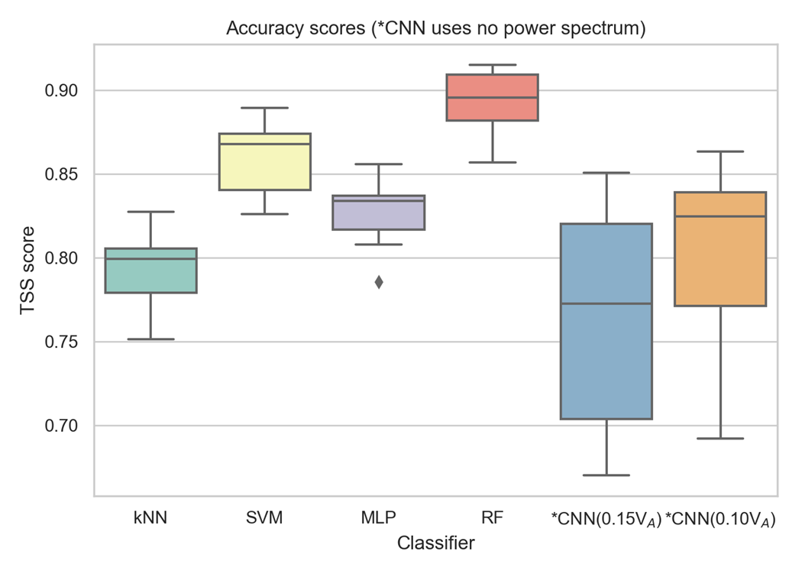
Testing power spectrum
No power spectrum
With power spectrum

Slide 55
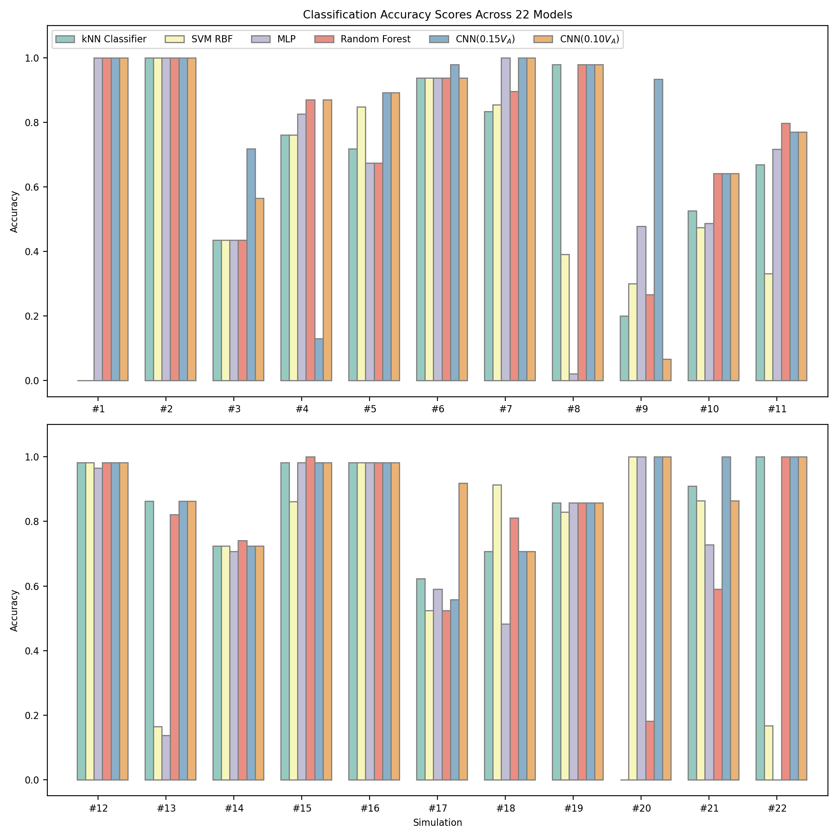
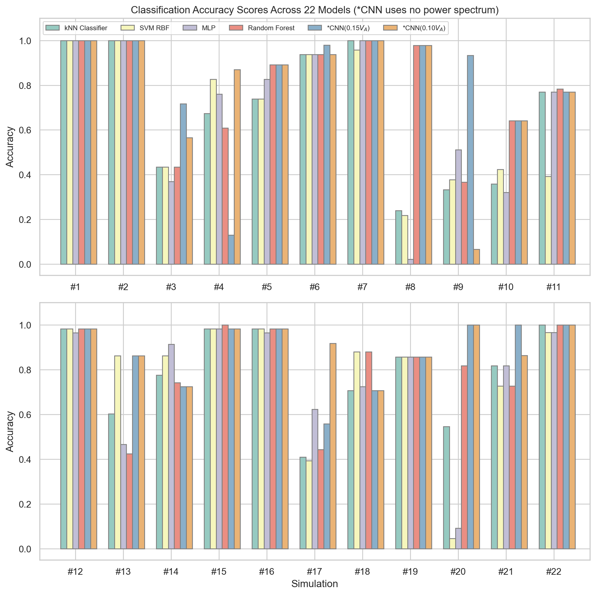

Slide 56
In progress (12/19/2024)

Slide 57
Simulation fields files
The timing of the fields files is not fractions of the gyrofrequency, but often several gyrofrequencies (ranging between 0.5 – 2.5 $Ω_{p}^{−1}$).
The used interpolation timing therefore is 2.5$Ω_{p}^{−1}$ (unified among models), the ‘observation’ integration timing
Another point is an integration time. For the testing purposes, let us have about 20 data points for the power spectrum reconstruction, therefore having an effective integration/observation time of 50$Ω_{p}^{−1}$
Next slide: more details on the timing for the case simulation

Slide 58
Detailed timing
vvvvvvvvvvvvvvvvvvvvvvvvvvvvvvvvvvvvvvvvvvvvvvvvvvvvvvvvvvvv
-> SIMULATION: ./fields.d10_A0.5Hepp_beta0.5eps1e-4_256
^^^^^^^^^^^^^^^^^^^^^^^^^^^^^^^^^^^^^^^^^^^^^^^^^^^^^^^^^^^^
Time step in proton gyroperiods : 2.5
vvvvvvvvvvvvvvvvvvvvvvvvvvvvvvvvvvvvvvvvvvvvvvvvvvvvvvvvvvvv
-> SIMULATION: ./fields.d10_A0.75Hepp_beta1_256
^^^^^^^^^^^^^^^^^^^^^^^^^^^^^^^^^^^^^^^^^^^^^^^^^^^^^^^^^^^^
Time step in proton gyroperiods : 2.5
vvvvvvvvvvvvvvvvvvvvvvvvvvvvvvvvvvvvvvvvvvvvvvvvvvvvvvvvvvvv
-> SIMULATION: ./fields.d10_E11Ap3.3Aa2.0Vd0.42
^^^^^^^^^^^^^^^^^^^^^^^^^^^^^^^^^^^^^^^^^^^^^^^^^^^^^^^^^^^^
Time step in proton gyroperiods : 1.25
vvvvvvvvvvvvvvvvvvvvvvvvvvvvvvvvvvvvvvvvvvvvvvvvvvvvvvvvvvvv
-> SIMULATION: ./fields.d10_E11Ap4.3Aa1.6
^^^^^^^^^^^^^^^^^^^^^^^^^^^^^^^^^^^^^^^^^^^^^^^^^^^^^^^^^^^^
Time step in proton gyroperiods : 1.25
vvvvvvvvvvvvvvvvvvvvvvvvvvvvvvvvvvvvvvvvvvvvvvvvvvvvvvvvvvvv
-> SIMULATION: ./fields.d10_E11Ap4.3Aa1.6Vd0.32
^^^^^^^^^^^^^^^^^^^^^^^^^^^^^^^^^^^^^^^^^^^^^^^^^^^^^^^^^^^^
Time step in proton gyroperiods/2pi : 1.25
vvvvvvvvvvvvvvvvvvvvvvvvvvvvvvvvvvvvvvvvvvvvvvvvvvvvvvvvvvvv
-> SIMULATION: ./fields.d10_E12Ap1.86Aa1.0Vd0.32_256_256x256
^^^^^^^^^^^^^^^^^^^^^^^^^^^^^^^^^^^^^^^^^^^^^^^^^^^^^^^^^^^^
Time step in proton gyroperiods/2pi : 2.5
vvvvvvvvvvvvvvvvvvvvvvvvvvvvvvvvvvvvvvvvvvvvvvvvvvvvvvvvvvvv
-> SIMULATION: ./fields.d10_E12Ap1.86Aa1.0Vd0.32_512_256x256
^^^^^^^^^^^^^^^^^^^^^^^^^^^^^^^^^^^^^^^^^^^^^^^^^^^^^^^^^^^^
Time step in proton gyroperiods : 2.5
vvvvvvvvvvvvvvvvvvvvvvvvvvvvvvvvvvvvvvvvvvvvvvvvvvvvvvvvvvvv
-> SIMULATION: ./fields.d10_He++A10_256_iden0eps0
^^^^^^^^^^^^^^^^^^^^^^^^^^^^^^^^^^^^^^^^^^^^^^^^^^^^^^^^^^^^
Time step in proton gyroperiods : 1.25
vvvvvvvvvvvvvvvvvvvvvvvvvvvvvvvvvvvvvvvvvvvvvvvvvvvvvvvvvvvv
-> SIMULATION: ./fields.d10_He++v2_256_iden0eps1e-4t600
^^^^^^^^^^^^^^^^^^^^^^^^^^^^^^^^^^^^^^^^^^^^^^^^^^^^^^^^^^^^
Time step in proton gyroperiods : 0.5
vvvvvvvvvvvvvvvvvvvvvvvvvvvvvvvvvvvvvvvvvvvvvvvvvvvvvvvvvvvv
-> SIMULATION: ./fields.d10_He++vd1.5_256_iden0eps1e-4
^^^^^^^^^^^^^^^^^^^^^^^^^^^^^^^^^^^^^^^^^^^^^^^^^^^^^^^^^^^^
Time step in proton gyroperiods : 1.25
vvvvvvvvvvvvvvvvvvvvvvvvvvvvvvvvvvvvvvvvvvvvvvvvvvvvvvvvvvvv
-> SIMULATION: ./fields.d10_pv1.5_128_64_iden0eps1e-4_dx0.75_long
^^^^^^^^^^^^^^^^^^^^^^^^^^^^^^^^^^^^^^^^^^^^^^^^^^^^^^^^^^^^
Time step in proton gyroperiods : 1.0
vvvvvvvvvvvvvvvvvvvvvvvvvvvvvvvvvvvvvvvvvvvvvvvvvvvvvvvvvvvv
-> SIMULATION: ./fields.d10_pv1Ap2Apb2betac0.214betab0.858_128_128x2_dx0.75_t3000
^^^^^^^^^^^^^^^^^^^^^^^^^^^^^^^^^^^^^^^^^^^^^^^^^^^^^^^^^^^^
Time step in proton gyroperiods : 1.0
vvvvvvvvvvvvvvvvvvvvvvvvvvvvvvvvvvvvvvvvvvvvvvvvvvvvvvvvvvvv
-> SIMULATION: ./fields.d10_pv2a_128x3_iden0eps1e-4_dx0.75
^^^^^^^^^^^^^^^^^^^^^^^^^^^^^^^^^^^^^^^^^^^^^^^^^^^^^^^^^^^^
Time step in proton gyroperiods : 1.0
vvvvvvvvvvvvvvvvvvvvvvvvvvvvvvvvvvvvvvvvvvvvvvvvvvvvvvvvvvvv
-> SIMULATION: ./fields.d10_pv2Ap1Ab1betac0.429betab0.858_128_128x2_dx0.75_t3000
^^^^^^^^^^^^^^^^^^^^^^^^^^^^^^^^^^^^^^^^^^^^^^^^^^^^^^^^^^^^
Time step in proton gyroperiods : 1.0
vvvvvvvvvvvvvvvvvvvvvvvvvvvvvvvvvvvvvvvvvvvvvvvvvvvvvvvvvvvv
-> SIMULATION: ./fields.d10_pv2Ap1Ab2betac0.429betab0.858_128_128x2_dx0.75_t3000
^^^^^^^^^^^^^^^^^^^^^^^^^^^^^^^^^^^^^^^^^^^^^^^^^^^^^^^^^^^^
Time step in proton gyroperiods : 1.0
vvvvvvvvvvvvvvvvvvvvvvvvvvvvvvvvvvvvvvvvvvvvvvvvvvvvvvvvvvvv
-> SIMULATION: ./fields.d10_pv2Ap2Apb2betac0.214betab0.858_128_128x2_dx0.75_t3000
^^^^^^^^^^^^^^^^^^^^^^^^^^^^^^^^^^^^^^^^^^^^^^^^^^^^^^^^^^^^
Time step in proton gyroperiods : 1.0
vvvvvvvvvvvvvvvvvvvvvvvvvvvvvvvvvvvvvvvvvvvvvvvvvvvvvvvvvvvv
-> SIMULATION: ./fields.d10_pv2av2.3_128x3_iden0eps1e-4_dx0.75
^^^^^^^^^^^^^^^^^^^^^^^^^^^^^^^^^^^^^^^^^^^^^^^^^^^^^^^^^^^^
Time step in proton gyroperiods : 1.0
vvvvvvvvvvvvvvvvvvvvvvvvvvvvvvvvvvvvvvvvvvvvvvvvvvvvvvvvvvvv
-> SIMULATION: ./fields.d10_pv2av2Ap1Aa1beta0.429_128_128x2_dx0.75_t3000
^^^^^^^^^^^^^^^^^^^^^^^^^^^^^^^^^^^^^^^^^^^^^^^^^^^^^^^^^^^^
Time step in proton gyroperiods : 1.0
vvvvvvvvvvvvvvvvvvvvvvvvvvvvvvvvvvvvvvvvvvvvvvvvvvvvvvvvvvvv
-> SIMULATION: ./fields.d10_pv2av2_rdna0.03375_128x3_iden0eps1e-4_dx0.75_t6000
^^^^^^^^^^^^^^^^^^^^^^^^^^^^^^^^^^^^^^^^^^^^^^^^^^^^^^^^^^^^
Time step in proton gyroperiods : 1.0
vvvvvvvvvvvvvvvvvvvvvvvvvvvvvvvvvvvvvvvvvvvvvvvvvvvvvvvvvvvv
-> SIMULATION: ./fields.d10_vap1.2Ap1Aa0.75_rdna_0.05
^^^^^^^^^^^^^^^^^^^^^^^^^^^^^^^^^^^^^^^^^^^^^^^^^^^^^^^^^^^^
Time step in proton gyroperiods : 2.5
vvvvvvvvvvvvvvvvvvvvvvvvvvvvvvvvvvvvvvvvvvvvvvvvvvvvvvvvvvvv
-> SIMULATION: ./fields.d10_vap1.2Ap3.35Aa2.05rdna_0.007
^^^^^^^^^^^^^^^^^^^^^^^^^^^^^^^^^^^^^^^^^^^^^^^^^^^^^^^^^^^^
Time step in proton gyroperiods : 2.5
vvvvvvvvvvvvvvvvvvvvvvvvvvvvvvvvvvvvvvvvvvvvvvvvvvvvvvvvvvvv
-> SIMULATION: ./fields.d10_vap1.5Ap1.5Aa1rdna_0.007
^^^^^^^^^^^^^^^^^^^^^^^^^^^^^^^^^^^^^^^^^^^^^^^^^^^^^^^^^^^^
Time step in proton gyroperiods : 2.5

Slide 59
fields.d10_E11Ap4.3Aa1.6Vd0.32
E_perp
0 ~f_p

Slide 60
fields.d10_E11Ap4.3Aa1.6Vd0.32: spectra
Normalized: entire domain
Normalized: per time step

Slide 61
Testing power spectrum
Understanding of how the wave spectrum (temporal only) can improve the detection of instabilities:
Interpolation of the fields with 2.5$Ω_{p}^{−1}$ time step (for consistency among different simulations)
Setup of observational time window to 50$Ω_{p}^{−1}$ centered at the corresponding VDF
Usage of 10 additional parameters (normalized power spectra at 10 frequency points) for the ML

Slide 62
Testing power spectrum
No spectrum:
ML model | TP | TN | FP | FN | Accuracy | TSS
kNN | 107±7 | 269±9 | 13±5 | 26±4 | 0.91±0.01 | 0.76±0.03
SVM RBF | 114±7 | 268±9 | 14±4 | 18±5 | 0.92±0.01 | 0.81±0.03
MLP (NN) | 109±8 | 270±8 | 12±4 | 23±4 | 0.91±0.01 | 0.78±0.03
Random Forest | 122±7 | 276±8 | 6±2 | 10±2 | 0.96±0.01 | 0.90±0.01
With spectrum:
ML model | TP | TN | FP | FN | Accuracy | TSS
kNN | 107±7 | 277±8 | 5±2 | 25±3 | 0.93±0.01 | 0.79±0.02
SVM RBF | 119±8 | 271±8 | 11±2 | 13±3 | 0.94±0.01 | 0.86±0.02
MLP (NN) | 116±8 | 268±8 | 14±4 | 16±3 | 0.93±0.01 | 0.83±0.01
Random Forest | 121±8 | 276±8 | 6±2 | 11±2 | 0.96±0.01 | 0.89±0.02

Slide 63
Testing power spectrum
No power spectrum
With power spectrum

Slide 64
Testing power spectrum
No power spectrum
With power spectrum

Slide 66
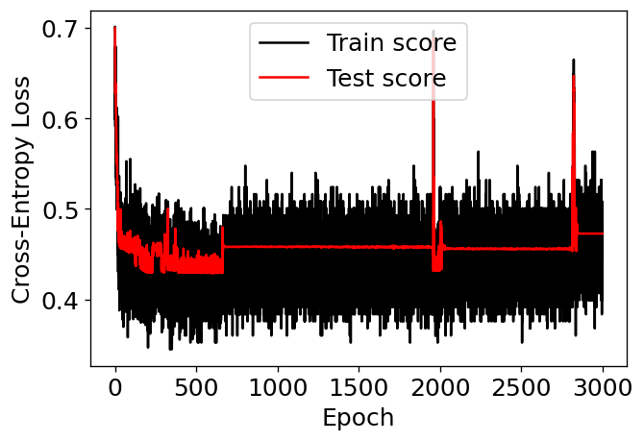
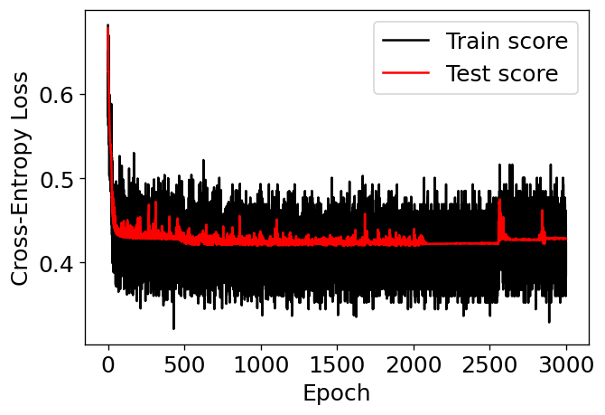
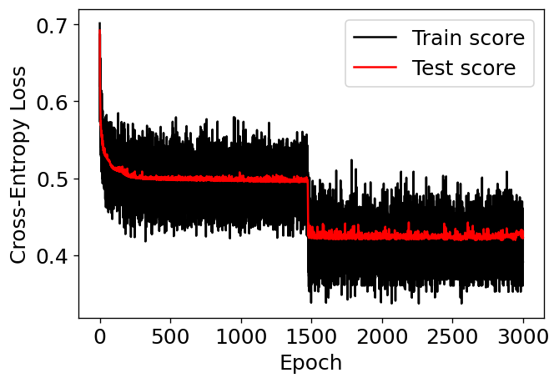
Problems with CNN training
Overfitting
Train-validation curves could look strange

Slide 67
Use of Regularization
L2 weight regularization: addition of the square of the weight into the functional times some coefficient
Naturally implemented in optimizers like Adam
Multiplier of wd=0.001 is used (trial and error approach)

Slide 68
Some results (preliminary, in progress)
Change in the most optimal architecture: the simper architectures start to work better
Improvement of the results. For example, for CNN working on 40x40 arrays:
Previously: 0.92 pm 0.02, TSS 0.76 pm 0.06
Now: accuracy 0.94 pm 0.03, TSS 0.82 pm 0.09
chmod –R 755 [dirname]

Slide 69
Currently doing: implementation of power spectrum into CNN network
Concatenating the power spectrum data into the fully-connected part of the network

